Slide 1
GovOps Web Security
Mike Nescot
Web Operations and Security Manager, JBS International

Slide 2
Agenda
Government IT Security Policy and Focus
DevOps Revolution and Promise
Open Source: Acceptance in Government
Version Control: Git, GitHub, Gerrit
Configuration Management: Puppet, Ansible
Virtualization: Vagrant, Docker
Continuous Integration: Jenkins
Monitoring: OSSIM, Prometheus
Communication: Slack, Social Networking
Cloud: Amazon and Azure
Future DevOps and Security

Slide 3
Government IT Security

Slide 4
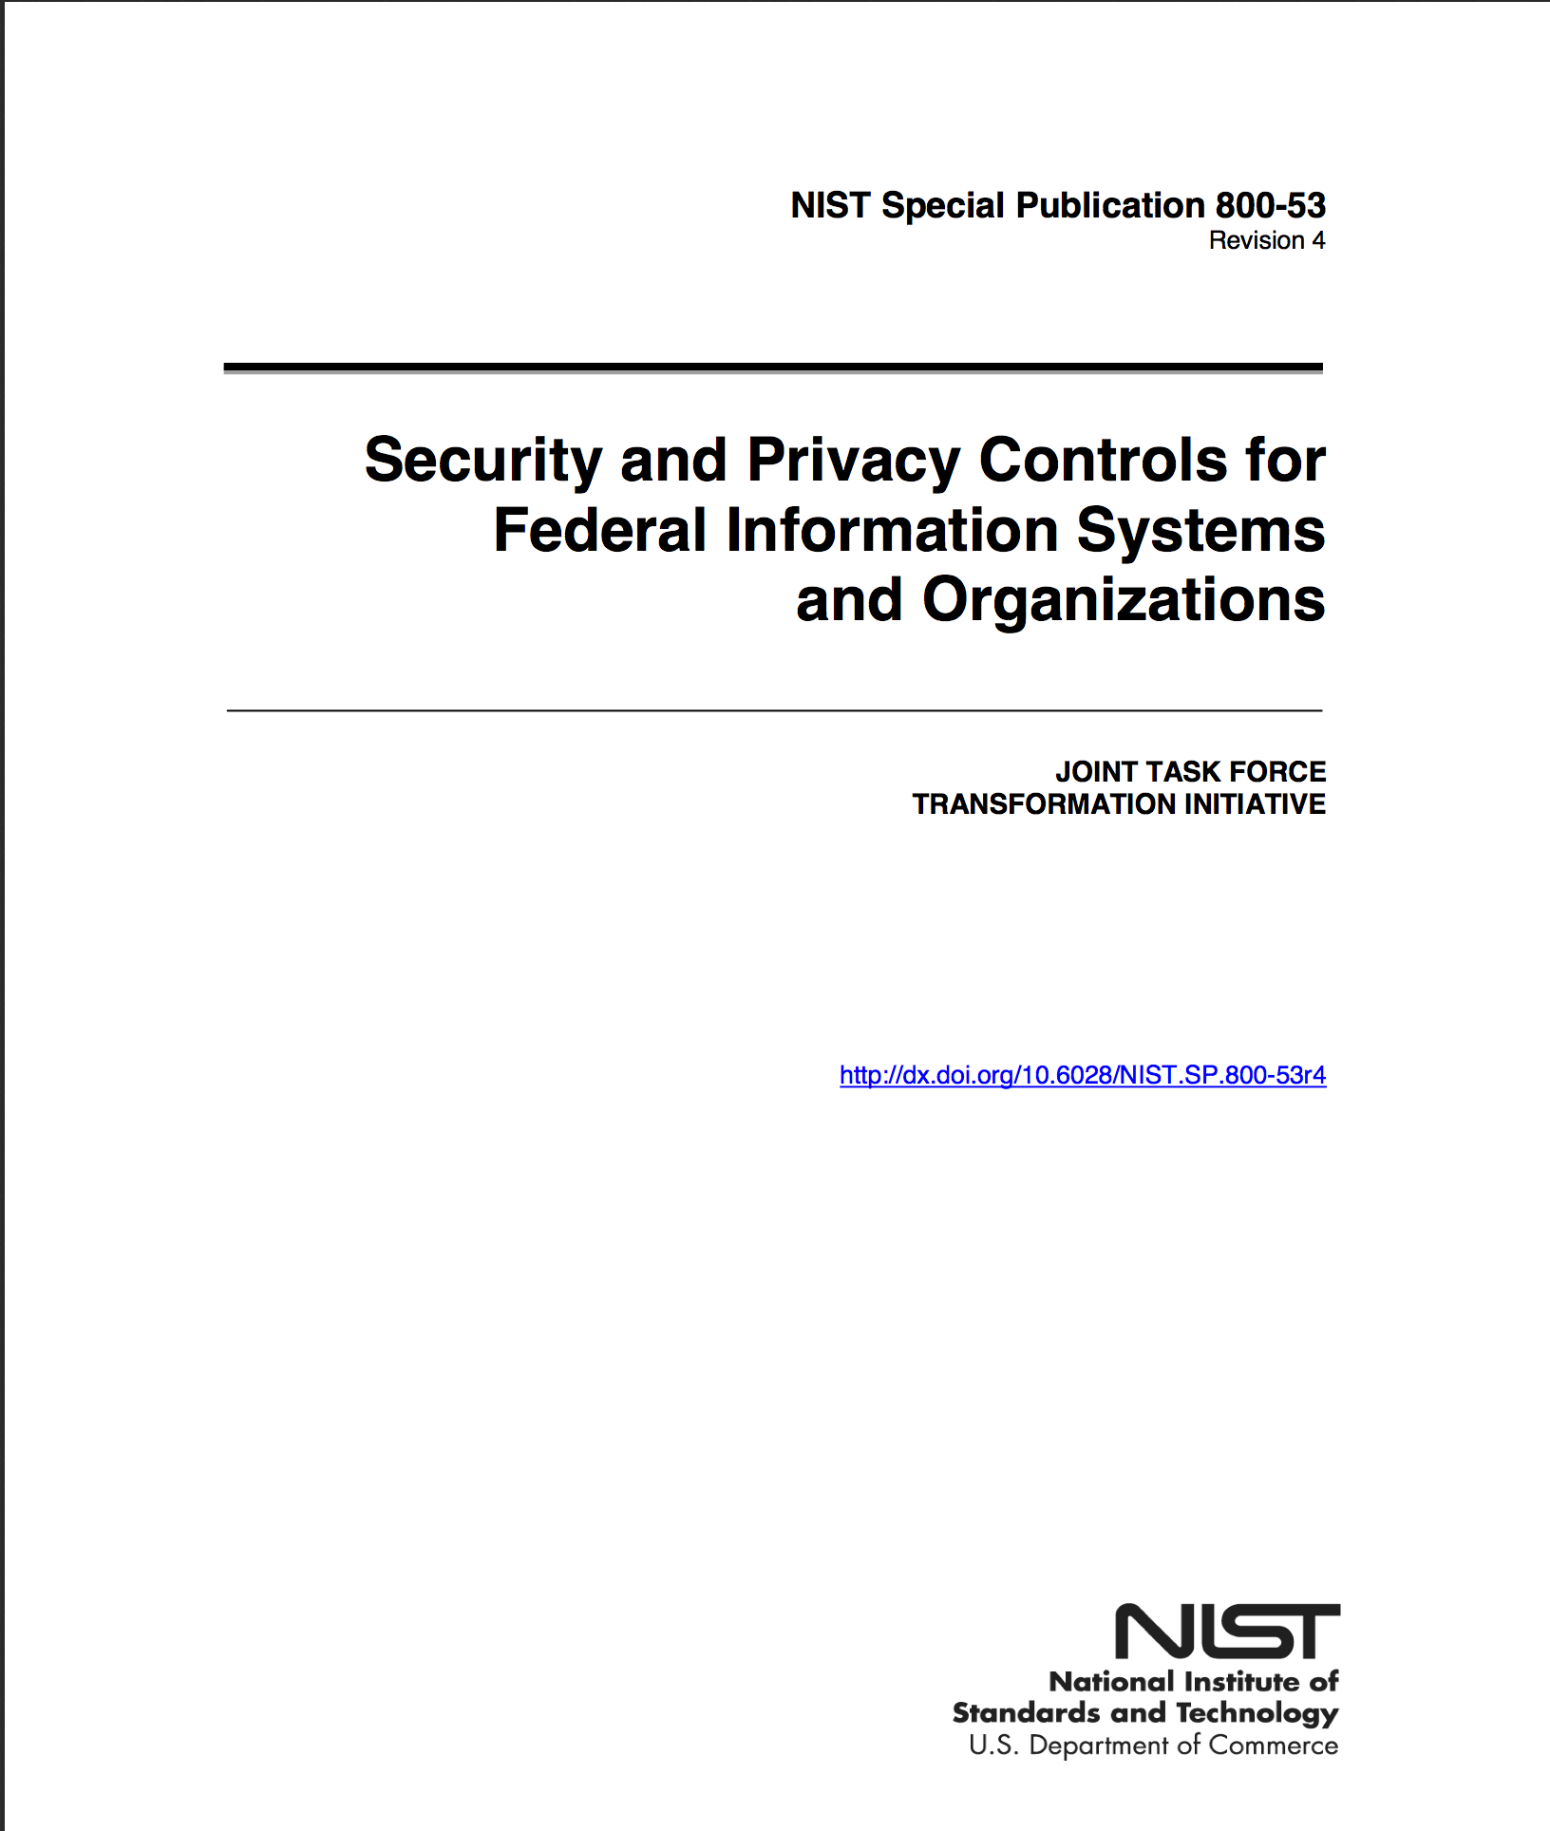
Security Controls: FISMA Standard, SP-53 Rev 4

Slide 5
SP800-53 Rev 4 Security Controls: 18 Families
Access Control
Awareness & Training
Audit & Accountability
Security Assessment & Authorization
Configuration Management
Contingency Planning
Identification & Authorization
Incident Response
Maintenance

Slide 6
SP800-53 Rev 4 Security Controls: 18 Families (con.)
Media Protection
Physical and Environmental Protection
Planning
Personnel Security
Risk Assessment
System and Services Acquisition
System & Communications Protection
System & Information Integrity
Program Management

Slide 7
SP800-53 Rev 4 Privacy Controls: 8 Families (FEA)
Authority & Purpose
Accountability, Audit, & Risk Management
Data Quality & Integrity
Data Minimization & Retention
Individual Participation & Redress
Security
Transparency
Use Limitation

Slide 8
New Focus
Insider threat
Application security (Build it Right & Continuously Monitor)
Supply chain risk
Security assurance and trustworthy systems
Mobile and cloud computing technologies
Advanced persistent threat
Tailoring guidance and overlays
Privacy

Slide 9
New Focus
Simplify
Specialize
Integrate
Strategic Risk-Based Approach

Slide 10
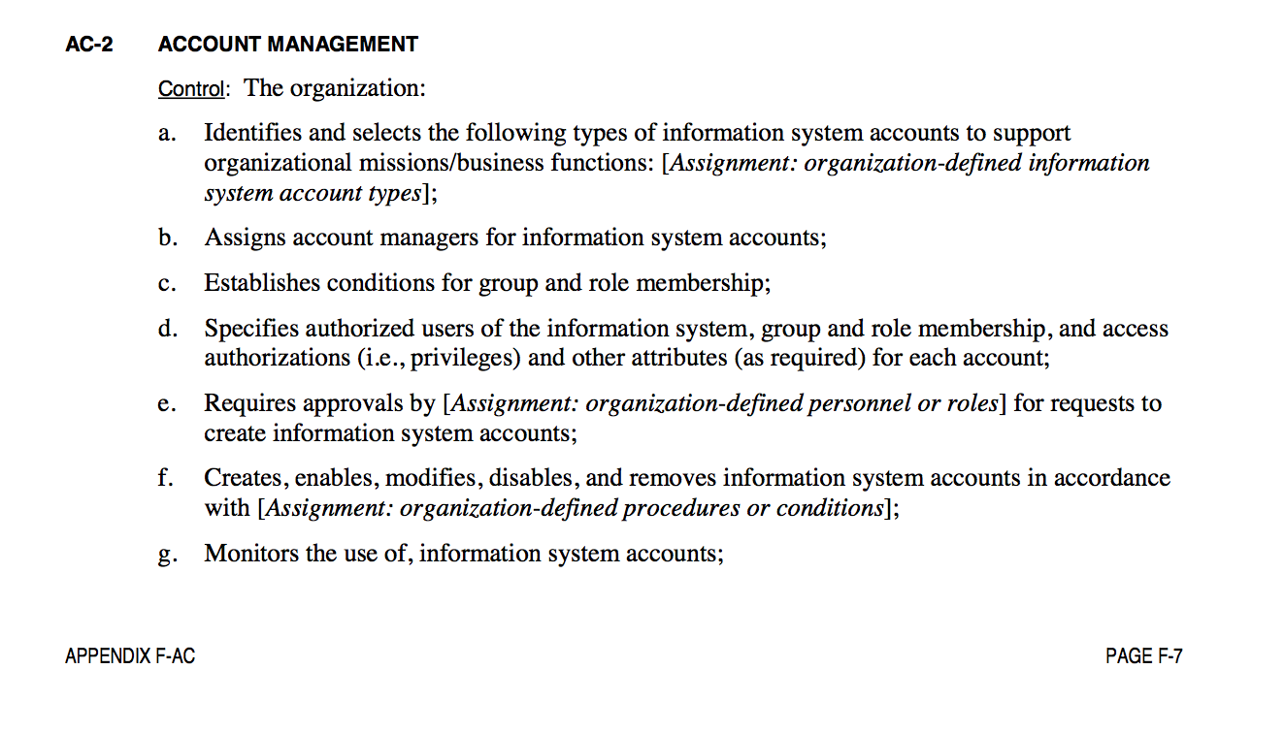
Anatomy of a Control

Slide 11
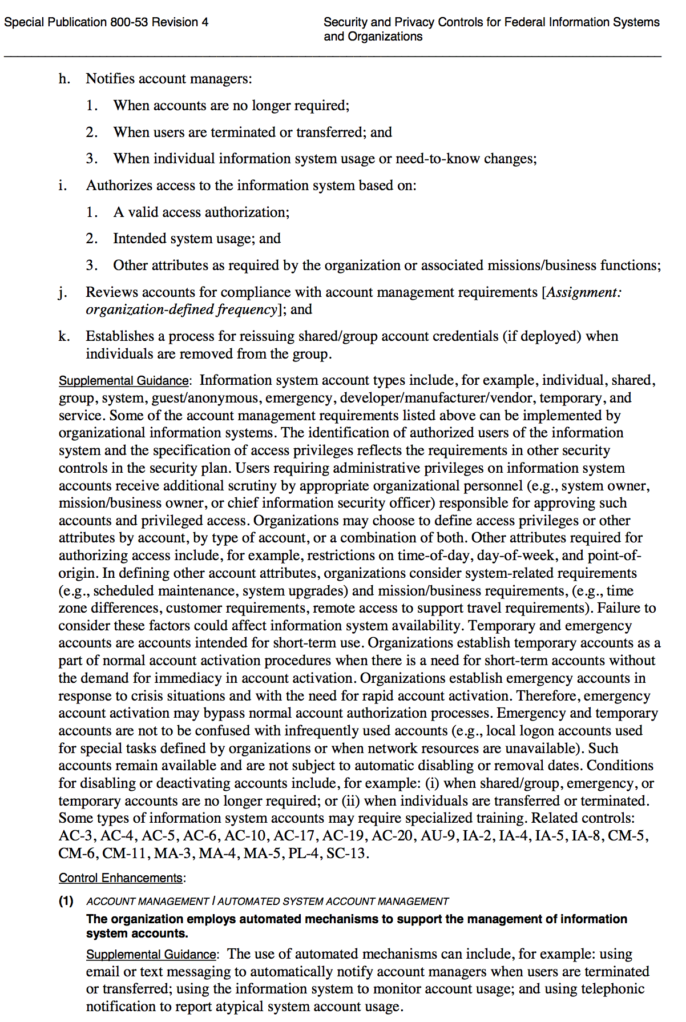
Anatomy of a Control

Slide 12
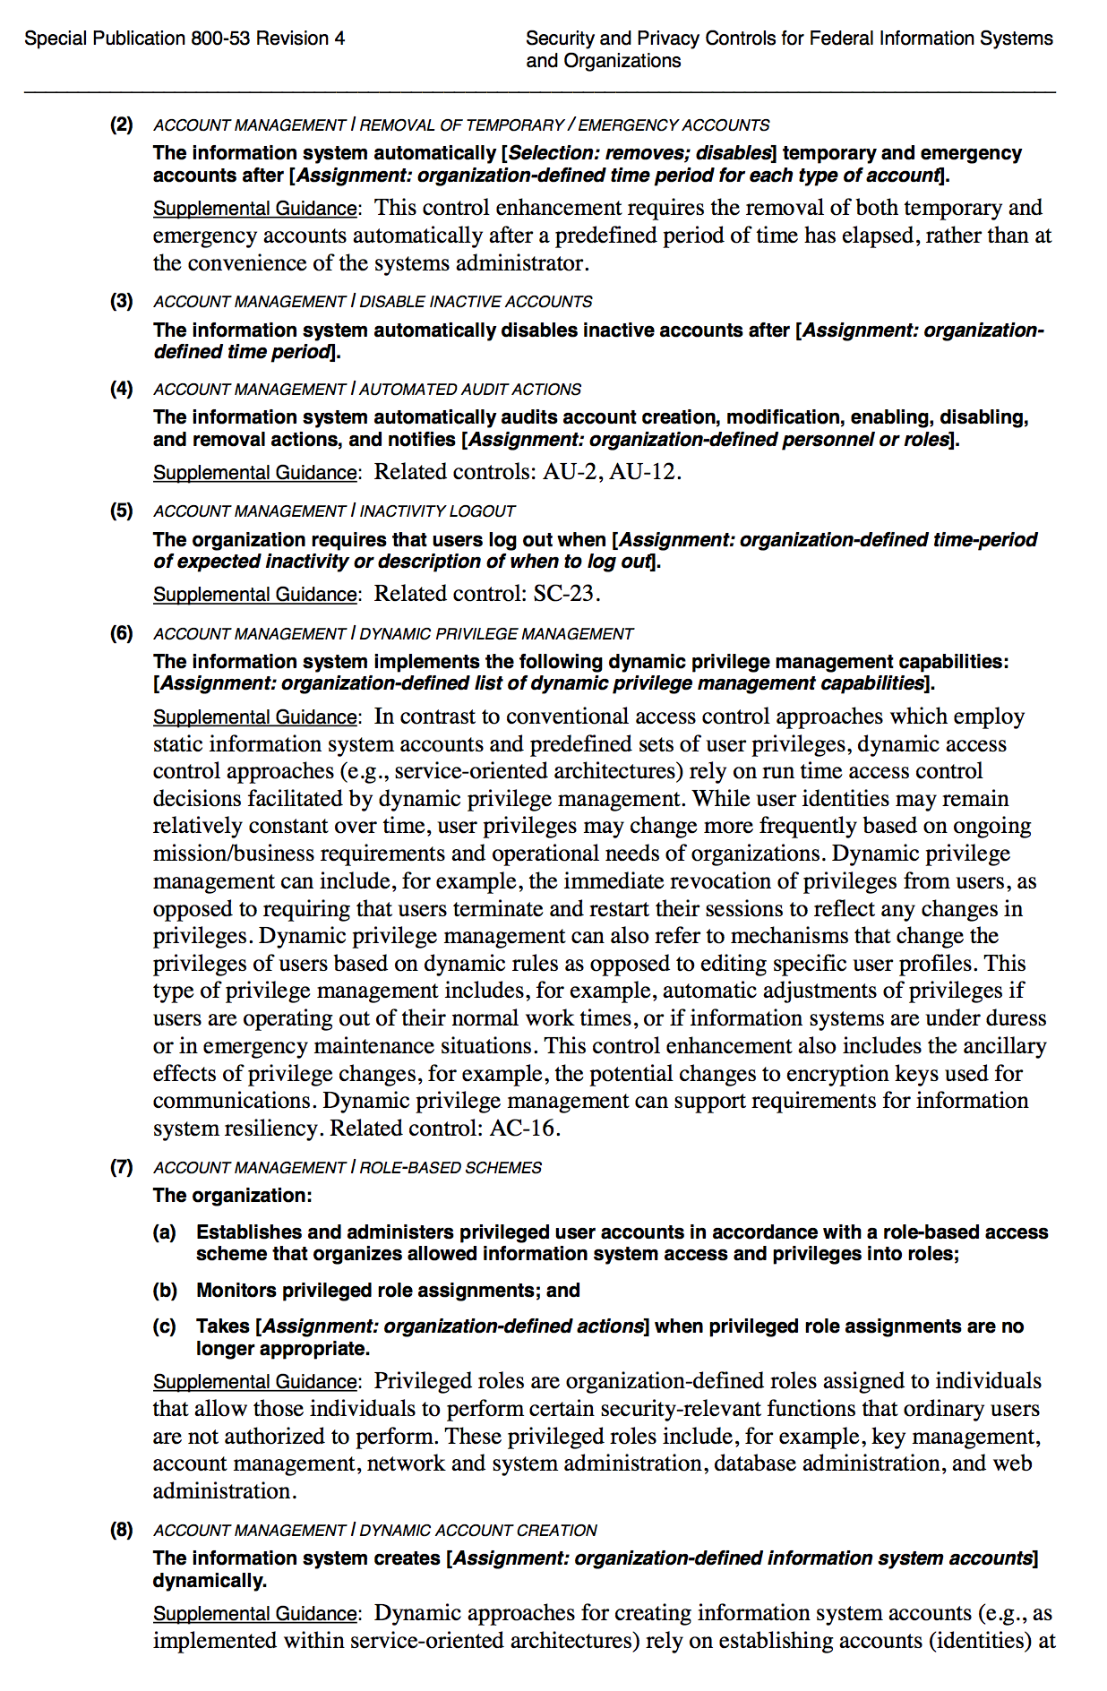
Anatomy of a Control

Slide 13
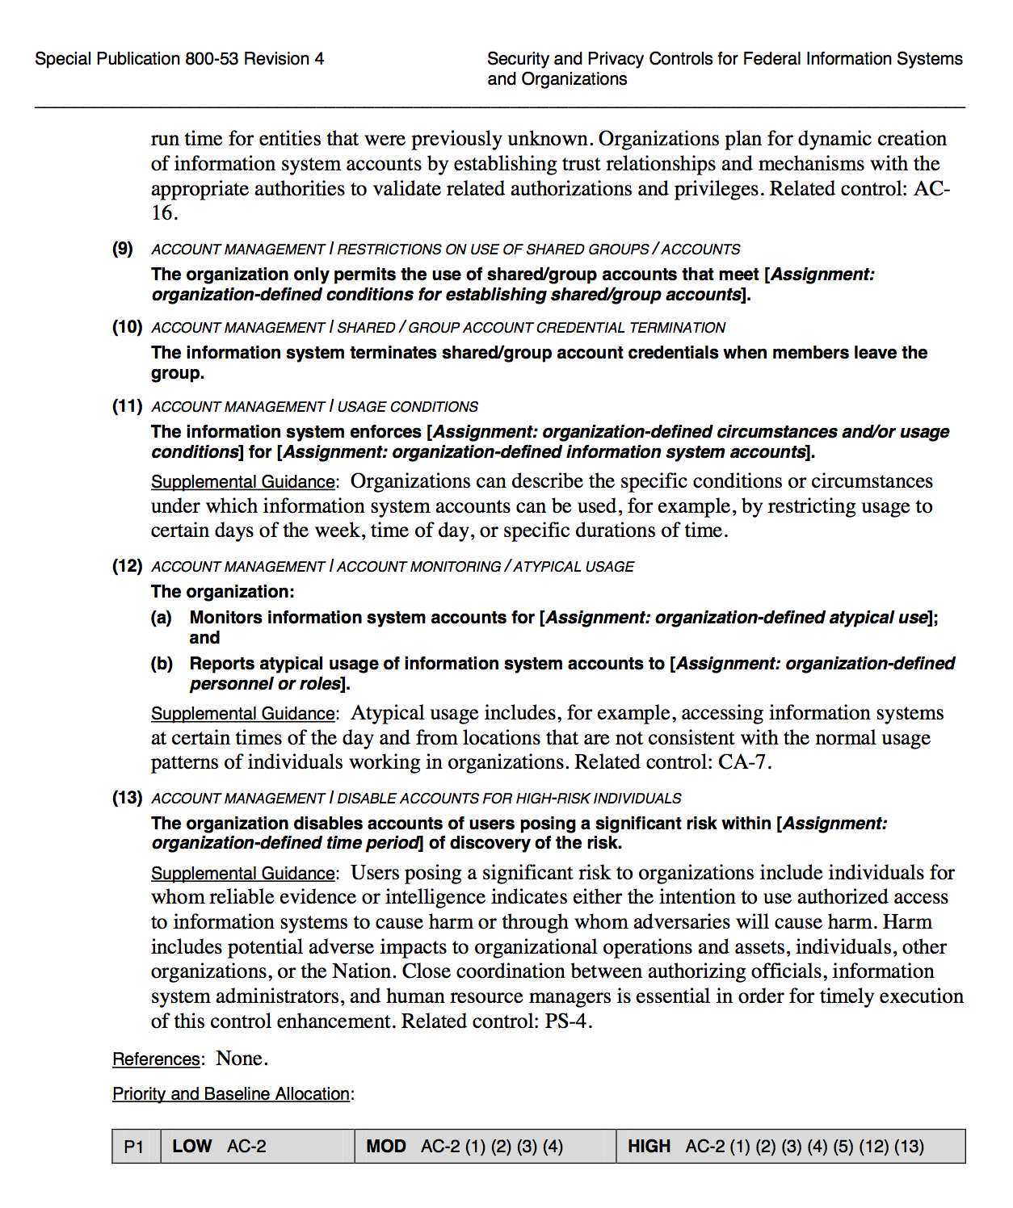
Anatomy of a Control

Slide 14
Anatomy of a Control
Control count: from 198 to 267, or 600 to 850
More tailoring guidance, overlays, focus on assurance controls, strategic, privacy
Overlays

Slide 15
SANS Top 20
Inventory of Authorized and Unauthorized Devices
Inventory of Authorized and Unauthorized Software
Secure Configurations for Hardware & Software on Laptops, Workstations, & Servers
Continuous Vulnerability Assessment and Remediation
Malware Defense
Application Software Security
Wireless Device Control
Data Recovery Capability
Security Skills Assessment & Training
Secure Configurations for Firewalls, Routers, & Switches

Slide 16
SANS Top 20 (cont)
Limitation & Control of Network Ports, Protocols, & Services
Controlled Use of Administrative Privileges
Boundary Defense
Maintenance, Monitoring, & Analysis of Audit Logs
Controlled Access Based on Need to Know
Account Monitoring & Control
Data Loss Prevention
Incident Response & Management
Secure Network Engineering
Penetration Testing & Team Exercises

Slide 17
SANS Top 20
The five critical tenets of an effective cyber defense system as reflected in the Critical Controls are:
Offense informs defense: Use knowledge of actual attacks for defense
Prioritization: Invest first in controls that will provide the greatest risk reduction and protection
Metrics: Establish common metrics to measure effectiveness
Continuous monitoring: Test and validate the effectiveness of current security measures.
Automation: Automate defenses, achieve reliable, scalable, and continuous measurements

Slide 18
State of Required Security Controls
Newly updated: NIST SP-53 Rev 4
SANS Top 20 Controls
Build it Right (SDLC), Continuous Monitoring
2011: NIST SP 800-137

Slide 19
Information Systems Continuous Monitoring (ISCM)
Maintaining ongoing awareness of information security, vulnerabilities, and threats to support organizational risk management decisions.
From compliance driven to data driven risk management

Slide 20
Conventional
Hostile cyber attacks
Natural disaster
Structural failures
Human errors of omission or commission
Strong Foundation

Slide 21
Advanced Persistent Threat
Significant expertise
Multiple attack vectors
Establishes footholds

Slide 22
Continuous Asset Evaluation, Situational Awareness, and Risk Scoring (CAESARS)
Reference Architecture: Security Automation Standards
Data Sources
Data Collection
Data Storage & Analysis
Consumer Presentation
Decisions

Slide 23
CAESARS Subsystems
Sensor (Assets, devices, servers, devices, appliances)
Database Sub (repository of configuration and inventory baselines)
Analysis/Scoring
Presentation (variety of views, query capabilities)

Slide 24
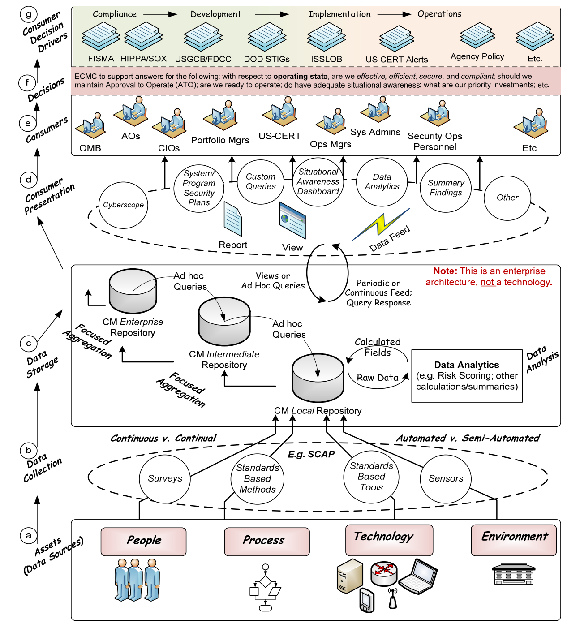

Slide 25
CAESARS
The end goal of CAESARS FE is to enable enterprise CM by presenting a technical reference model that allows organizations to aggregate collected data from across a diverse set of security tools, analyze that data, perform scoring, enable user queries, and provide overall situational awareness.

Slide 26
Security Capability
What is a NIST “Security Capability”?
A (NIST) security capability means:
A collection (set) of security controls that work together to achieve an overall
security purpose. (NIST 800-53 Rev4, p. 21.)
NIST notes that focusing on “security capabilities” improves/supports risk
management:
• The failure of multiple controls, may not affect the overall security capability needed by an
organization.
• Moreover, employing … security capabilities allows an organization to … determine if the failure
of a particular security control … affects the overall capability needed for mission/business
protection.
• Ultimately, authorization decisions (i.e., risk acceptance decisions) are made based on the
degree to which the desired security capabilities have been effectively achieved and are
meeting the security requirements defined by an organization.

Slide 27
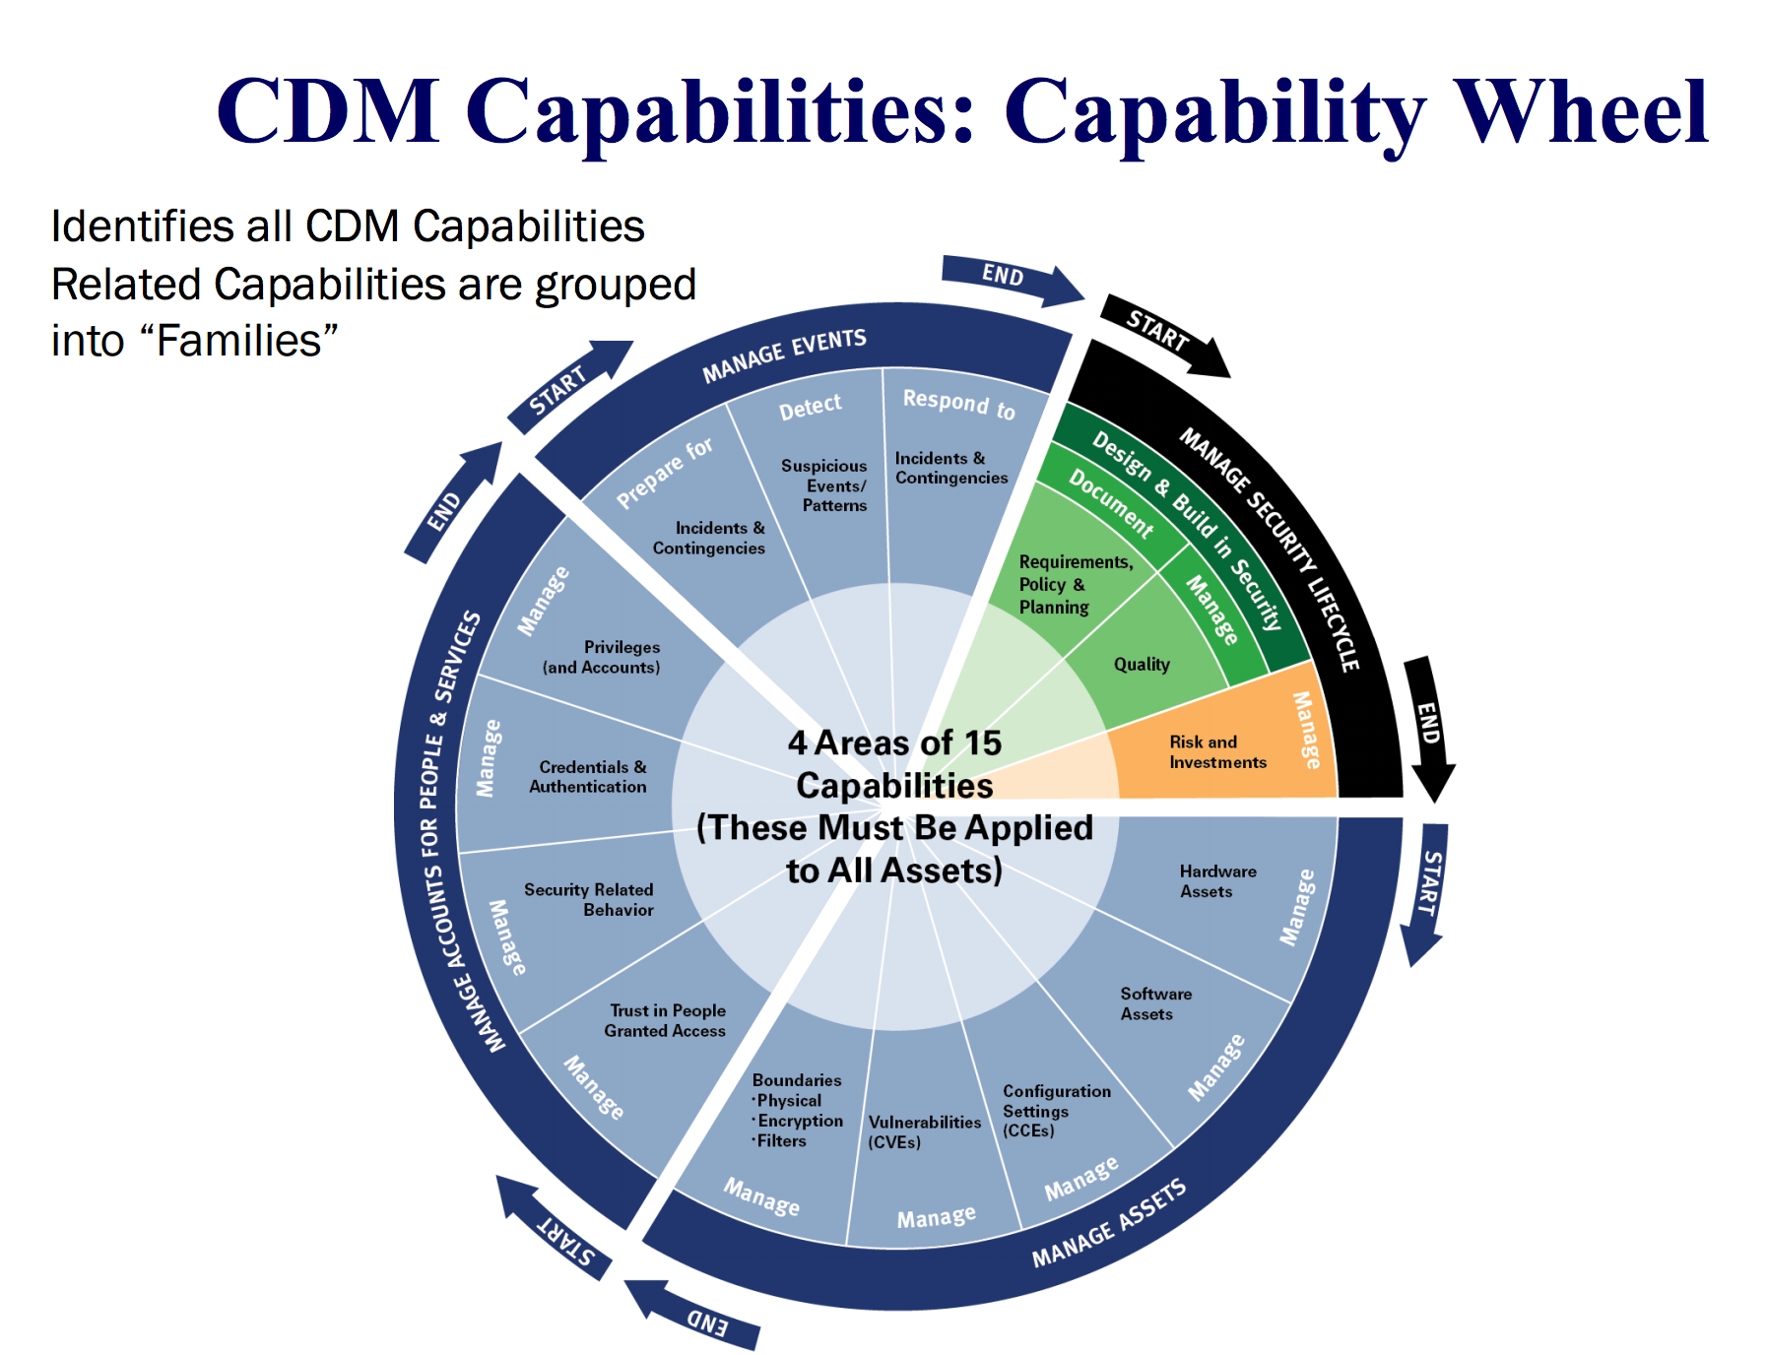

Slide 28
Cybersecurity Framework
Building from those standards, guidelines, and practices, the Framework provides a common
taxonomy and mechanism for organizations to:
1) Describe their current cybersecurity posture;
2) Describe their target state for cybersecurity;
3) Identify and prioritize opportunities for improvement within the context of a
continuous and repeatable process;
4) Assess progress toward the target state;
5) Communicate among internal and external stakeholders about cybersecurity risk.

Slide 29
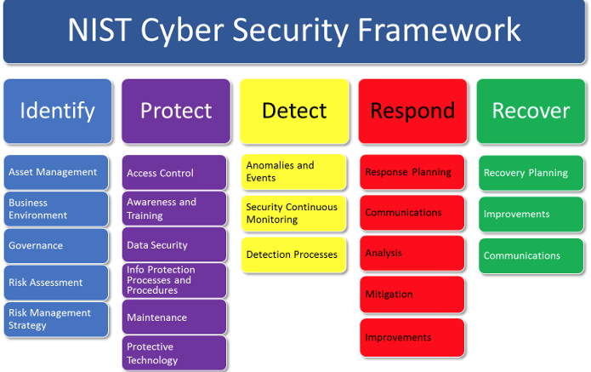

Slide 30
Cybersecurity Framework
Tier 1: Partial
Risk Management Process – Organizational cybersecurity risk management practices are
not formalized, and risk is managed in an ad hoc and sometimes reactive manner.
Prioritization of cybersecurity activities may not be directly informed by organizational
risk objectives, the threat environment, or business/mission requirements.
• Integrated Risk Management Program – There is limited awareness of cybersecurity risk
at the organizational level and an organization-wide approach to managing cybersecurity
risk has not been established. The organization implements cybersecurity risk
management on an irregular, case-by-case basis due to varied experience or information
gained from outside sources. The organization may not have processes that enable
cybersecurity information to be shared within the organization.
• External Participation – An organization may not have the processes in place to
participate in coordination or collaboration with other entities.

Slide 31
Cybersecurity Framework
Tier 2: Risk Informed
• Risk Management Process – Risk management practices are approved by management
but may not be established as organizational-wide policy. Prioritization of cybersecurity
activities is directly informed by organizational risk objectives, the threat environment, or
business/mission requirements.
• Integrated Risk Management Program – There is an awareness of cybersecurity risk at
the organizational level but an organization-wide approach to managing cybersecurity
risk has not been established. Risk-informed, management-approved processes and
procedures are defined and implemented, and staff has adequate resources to perform
their cybersecurity duties. Cybersecurity information is shared within the organization on
an informal basis.
• External Participation – The organization knows its role in the larger ecosystem, but has
not formalized its capabilities to interact and share information externally.

Slide 32
Cybersecurity Framework
Tier 3: Repeatable
• Risk Management Process – The organization’s risk management practices are formally
approved and expressed as policy. Organizational cybersecurity practices are regularly
updated based on the application of risk management processes to changes in
business/mission requirements and a changing threat and technology landscape.
• Integrated Risk Management Program – There is an organization-wide approach to
manage cybersecurity risk. Risk-informed policies, processes, and procedures are
defined, implemented as intended, and reviewed. Consistent methods are in place to
respond effectively to changes in risk. Personnel possess the knowledge and skills to
perform their appointed roles and responsibilities.
• External Participation – The organization understands its dependencies and partners and
receives information from these partners that enables collaboration and risk-based
management decisions within the organization in response to events.

Slide 33
Cybersecurity Framework
Tier 4: Adaptive
• Risk Management Process – The organization adapts its cybersecurity practices based on
lessons learned and predictive indicators derived from previous and current cybersecurity
activities. Through a process of continuous improvement incorporating advanced
cybersecurity technologies and practices, the organization actively adapts to a changing
cybersecurity landscape and responds to evolving and sophisticated threats in a timely
manner.
• Integrated Risk Management Program – There is an organization-wide approach to
managing cybersecurity risk that uses risk-informed policies, processes, and procedures
to address potential cybersecurity events. Cybersecurity risk management is part of the
organizational culture and evolves from an awareness of previous activities, information
shared by other sources, and continuous awareness of activities on their systems and
networks.
• External Participation – The organization manages risk and actively shares information
with partners to ensure that accurate, current information is being distributed and
consumed to improve cybersecurity before a cybersecurity event occur

Slide 34
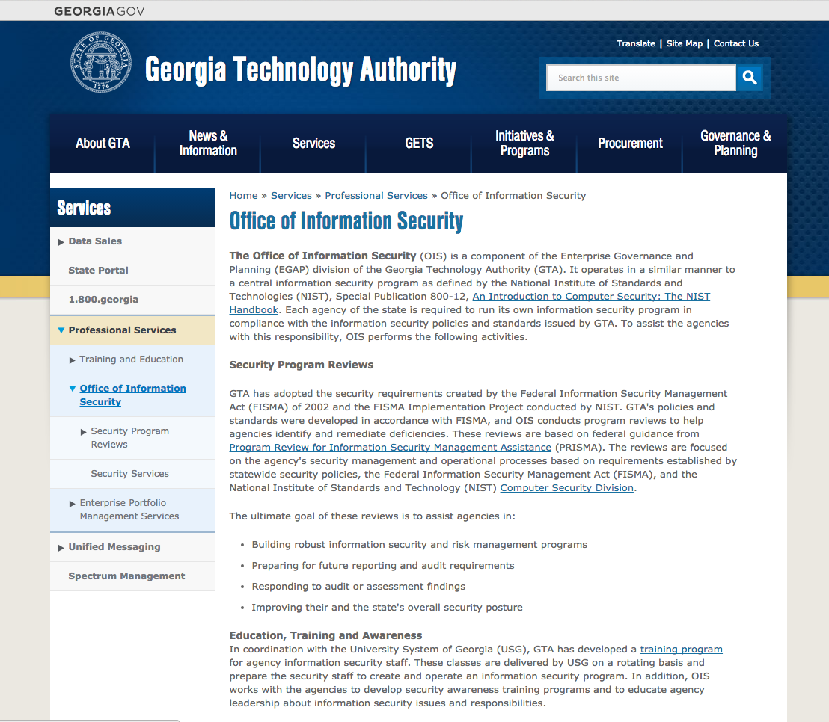

Slide 35
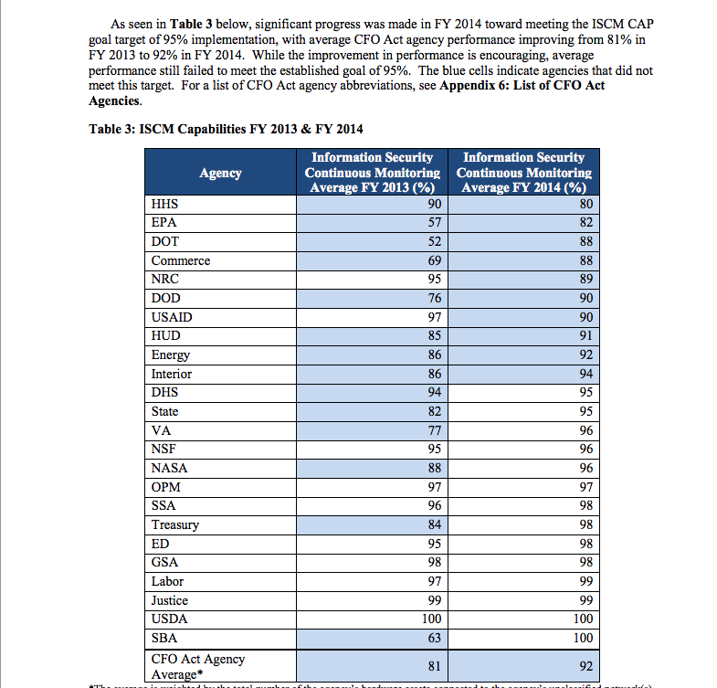

Slide 36
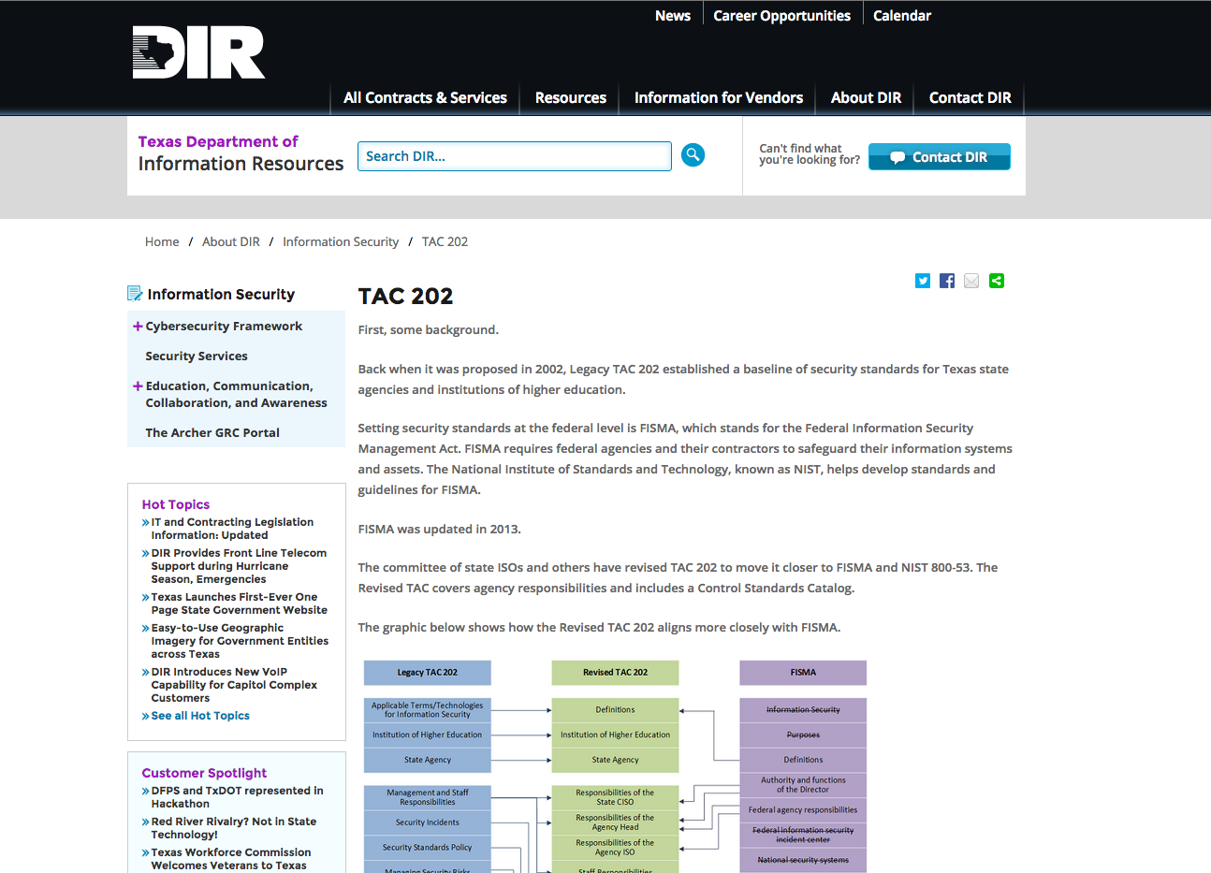

Slide 37
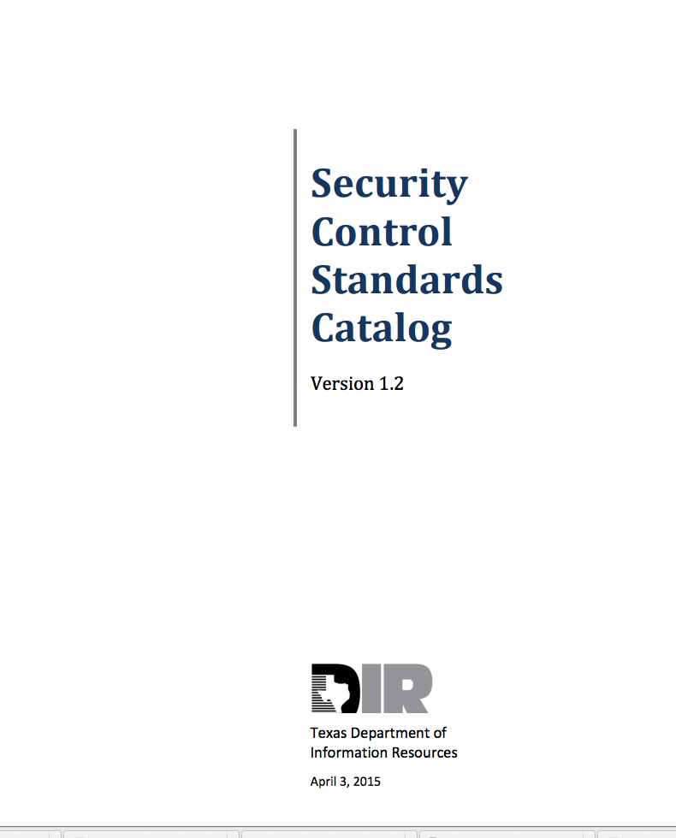

Slide 38
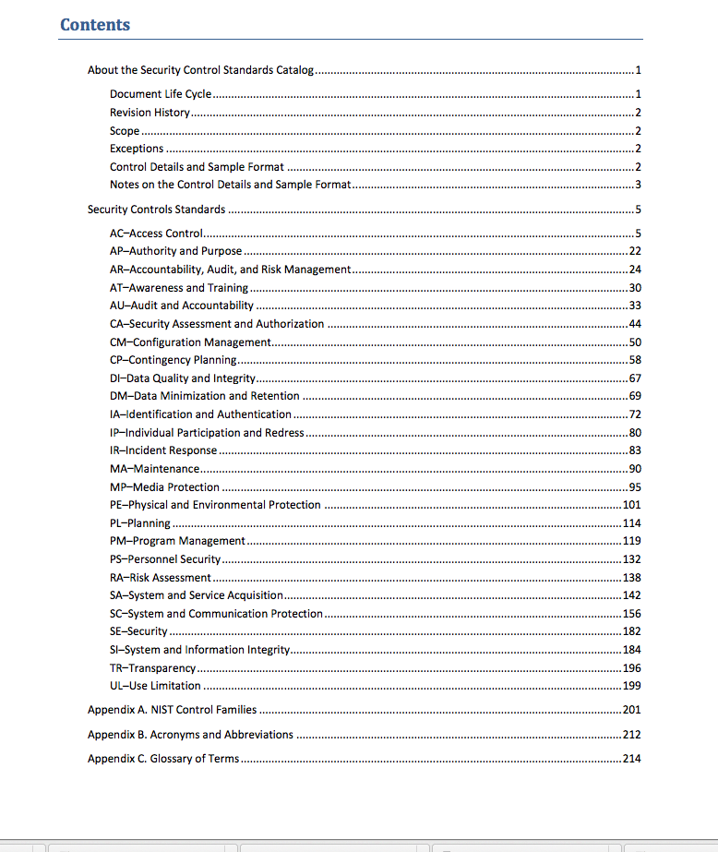

Slide 39
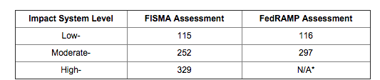

Slide 40
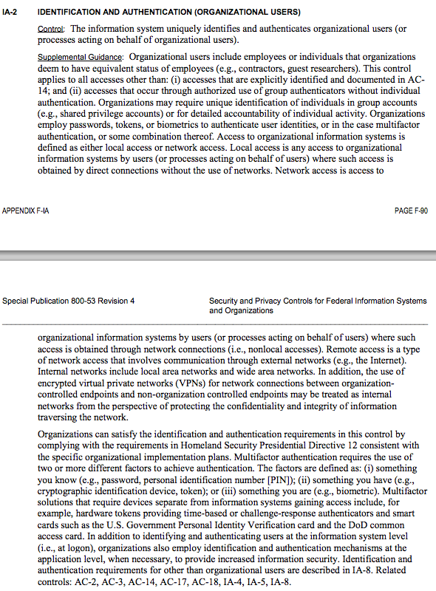

Slide 41
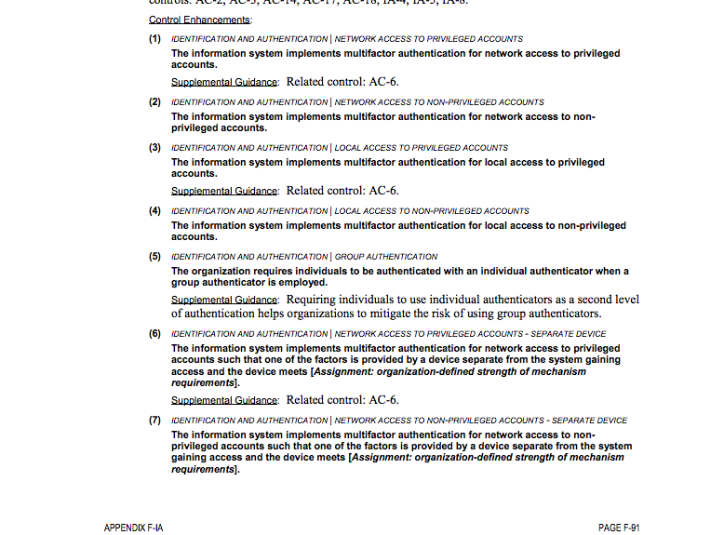

Slide 42
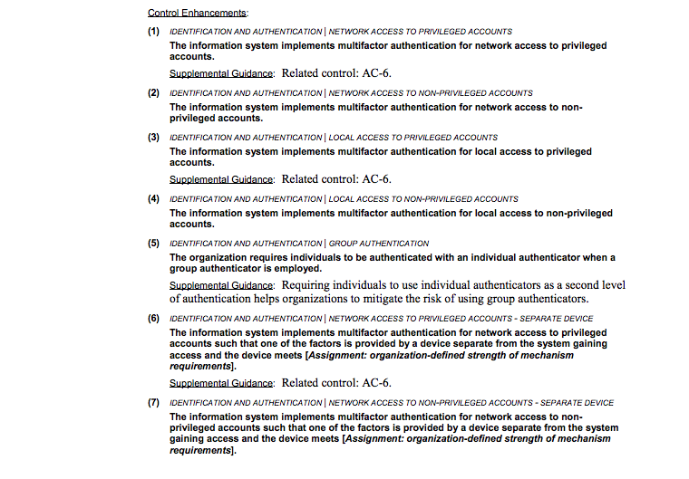

Slide 43
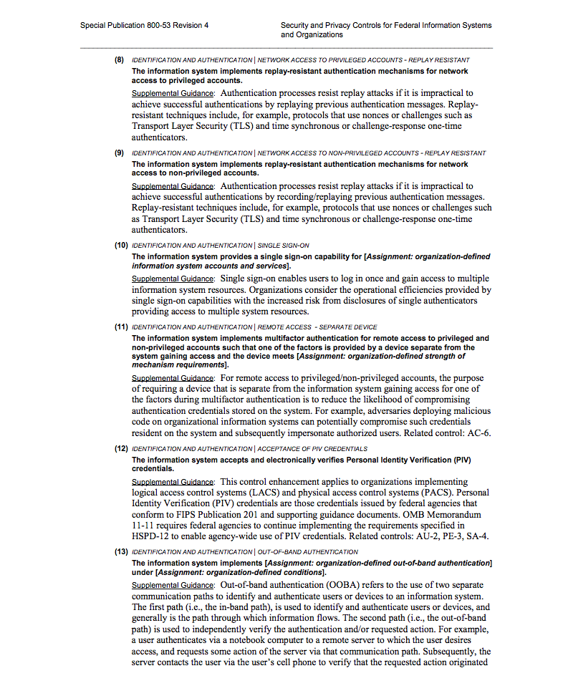

Slide 44
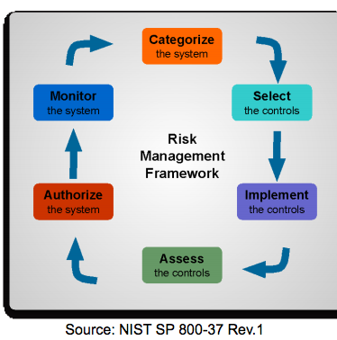
Risk Management Framework

Slide 45
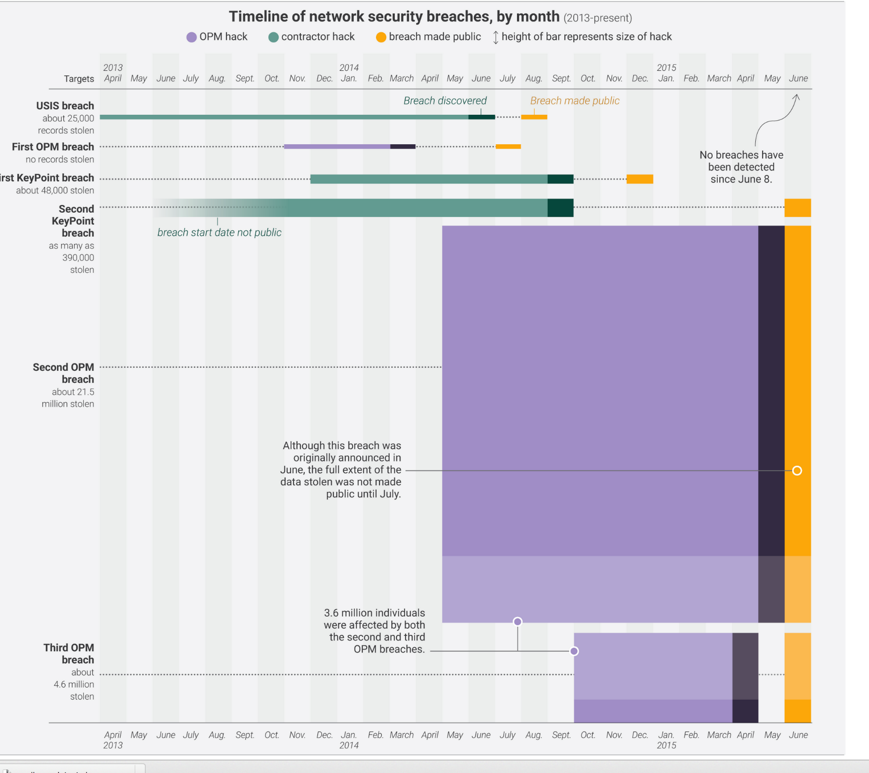

Slide 46
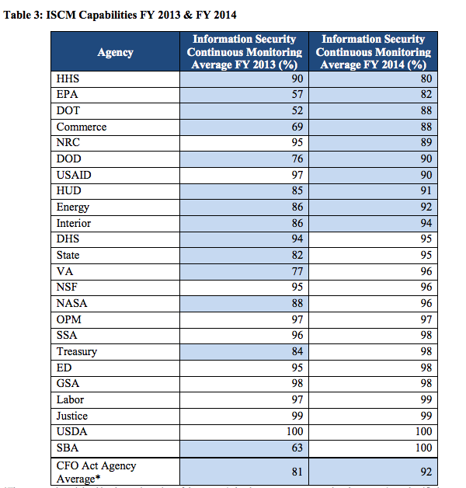

Slide 47
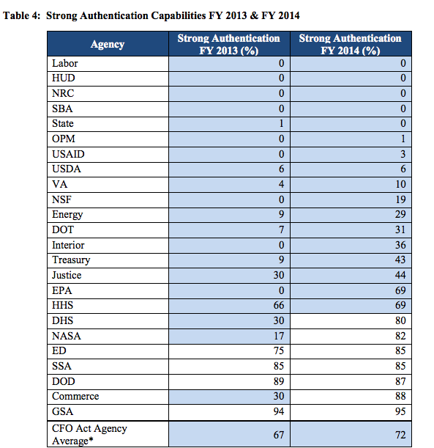

Slide 48
DevOps Revolution

Slide 49
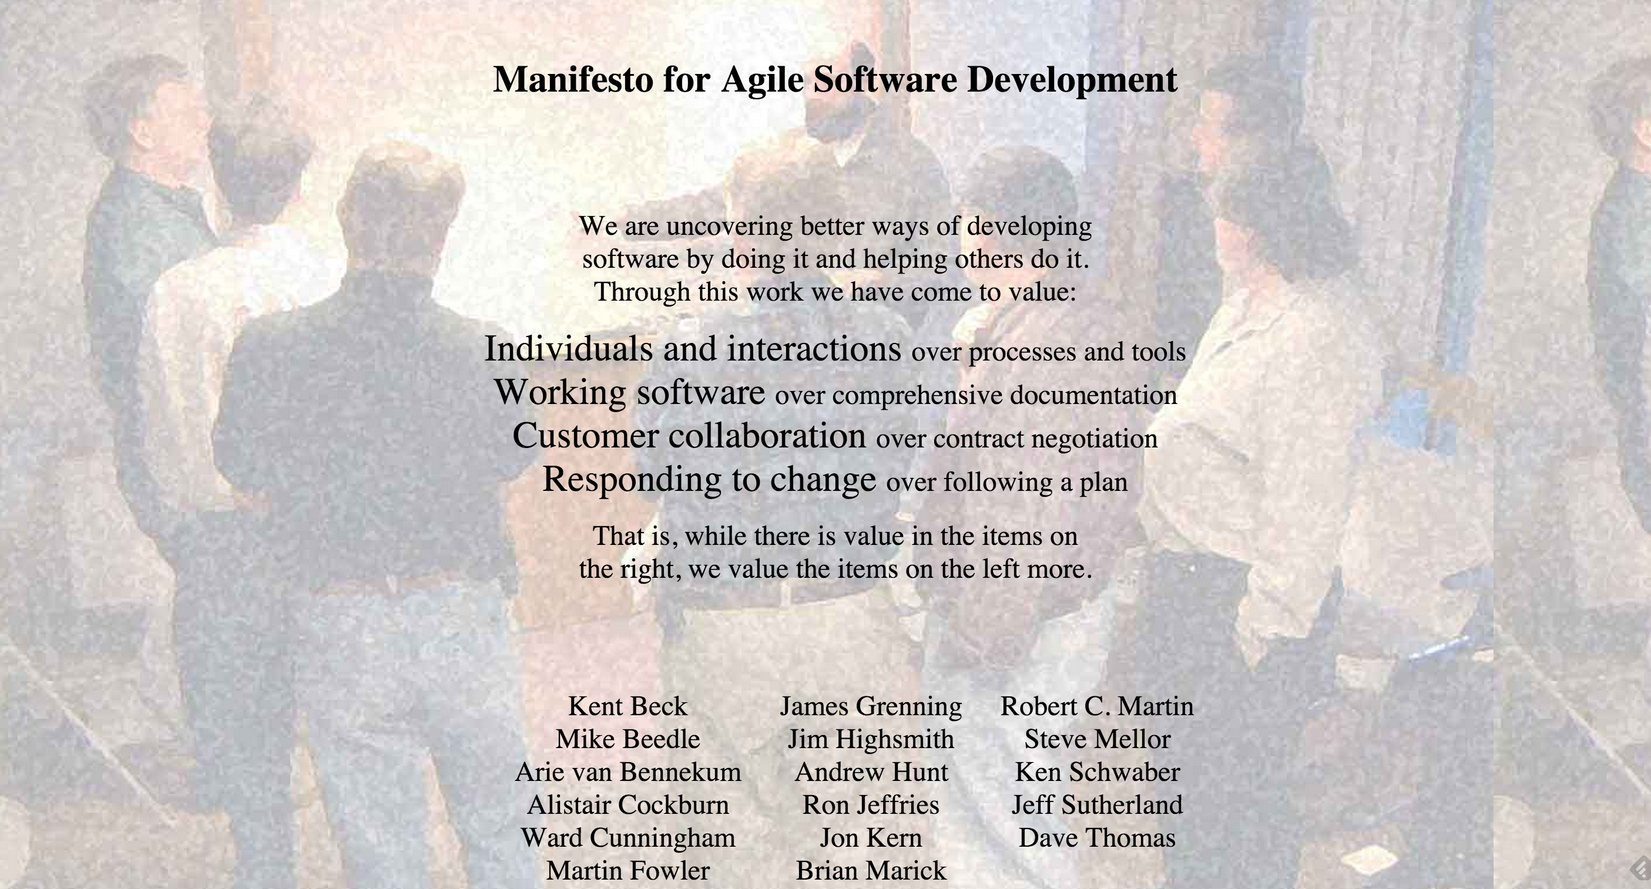

Slide 50
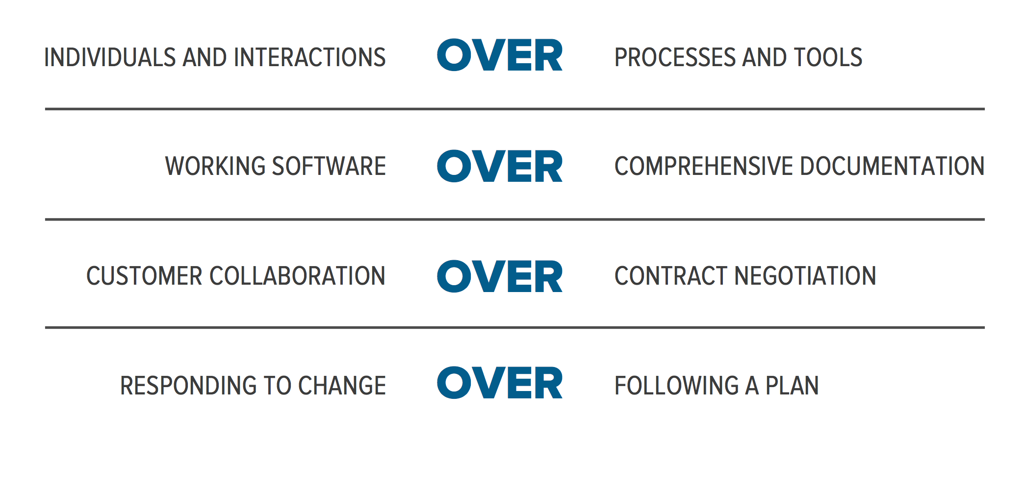

Slide 51
John Willis: 3 Threads: Agile Infrastructure
Patrick Dubois and Andrew Schafer 2008 Agile Infrastruture conferecne BOF
Marcel Wegerman had started an agile-sysadmin mailing list: promoted bridge between development and systems administration.
DevOps Days Ghent 2009 : (DevOps Manifesto lowering the risk of change through tools and culture
DevOps Days in Moutainview in 2010

Slide 52
John Willis: 3 Threads: Velocity
John Aspaw 2009 Velocity presentation: “10+ Deploys Per Day,” operations needed to change
Jessie Robbins, 2007: “Operations is a competitive advantage… (Secret Sauce for Startups!)”
Tim O’Reilly, 2006: “Operations: The New Secret Sauce.”

Slide 53
John Willis: 3 Threads: Lean Startup
Stephen Blank: Four Steps to Epiphany Eric Reis: Lessons Learned, Wealthfront, Lean Startup
Jes Humble: Continuous Delivery, Lean Enterprise

Slide 54
John Willis: 3 Threads: Continuous Improvement
Continuous quality imporovement (CQI)
Total quality management (TQM
Deming, Toyota
Team accountability and contribution

Slide 55
Gene Kim
Visible Ops serieVisible Ops: ITIL
Release Management:
Rebuild instead of Repair:
automated process, known amount of time
-less config variance
-less complicated, done by junior staff
-senior staff work on systemic issues
-eliminate unplanned work
Repeatable build processed
-golden builds stored in DSL (definitive software library(
DSL-CMDB
-create list of supported components :
a. infrastructure and operating systems
b. applications
c. busness rules
d. data
-define, combine, and reuse components (web and db server build may share os)
-vmware to create identical virtual servers
-develop refererence builds that can provision without human intervento
-release management team put builds into DSL that are deployed by operating team
-no developers should be part of the build process both for security and to advance the operations staff's ability to provision and maintain infrastructure unaided
-patch and pray, test patches on pre-production systems
-patching in production can easily create errors, accumulate latent errors
-automated detection of changes
1. -jumptstart, kickstart, Dockerfile
Visible OPS Security:
Create situational awareness
Embed security contorols in operations
Risk-based approch, most valuable assets
Phoenix Project

Slide 56
Continuous Delivery
Netflix: 100’s of deployments per day
Amazon: Changes to production every 11.6 seconds on average in May of 2011
Facebook: Releases to production twice
Google: Developed on mainline

Slide 57
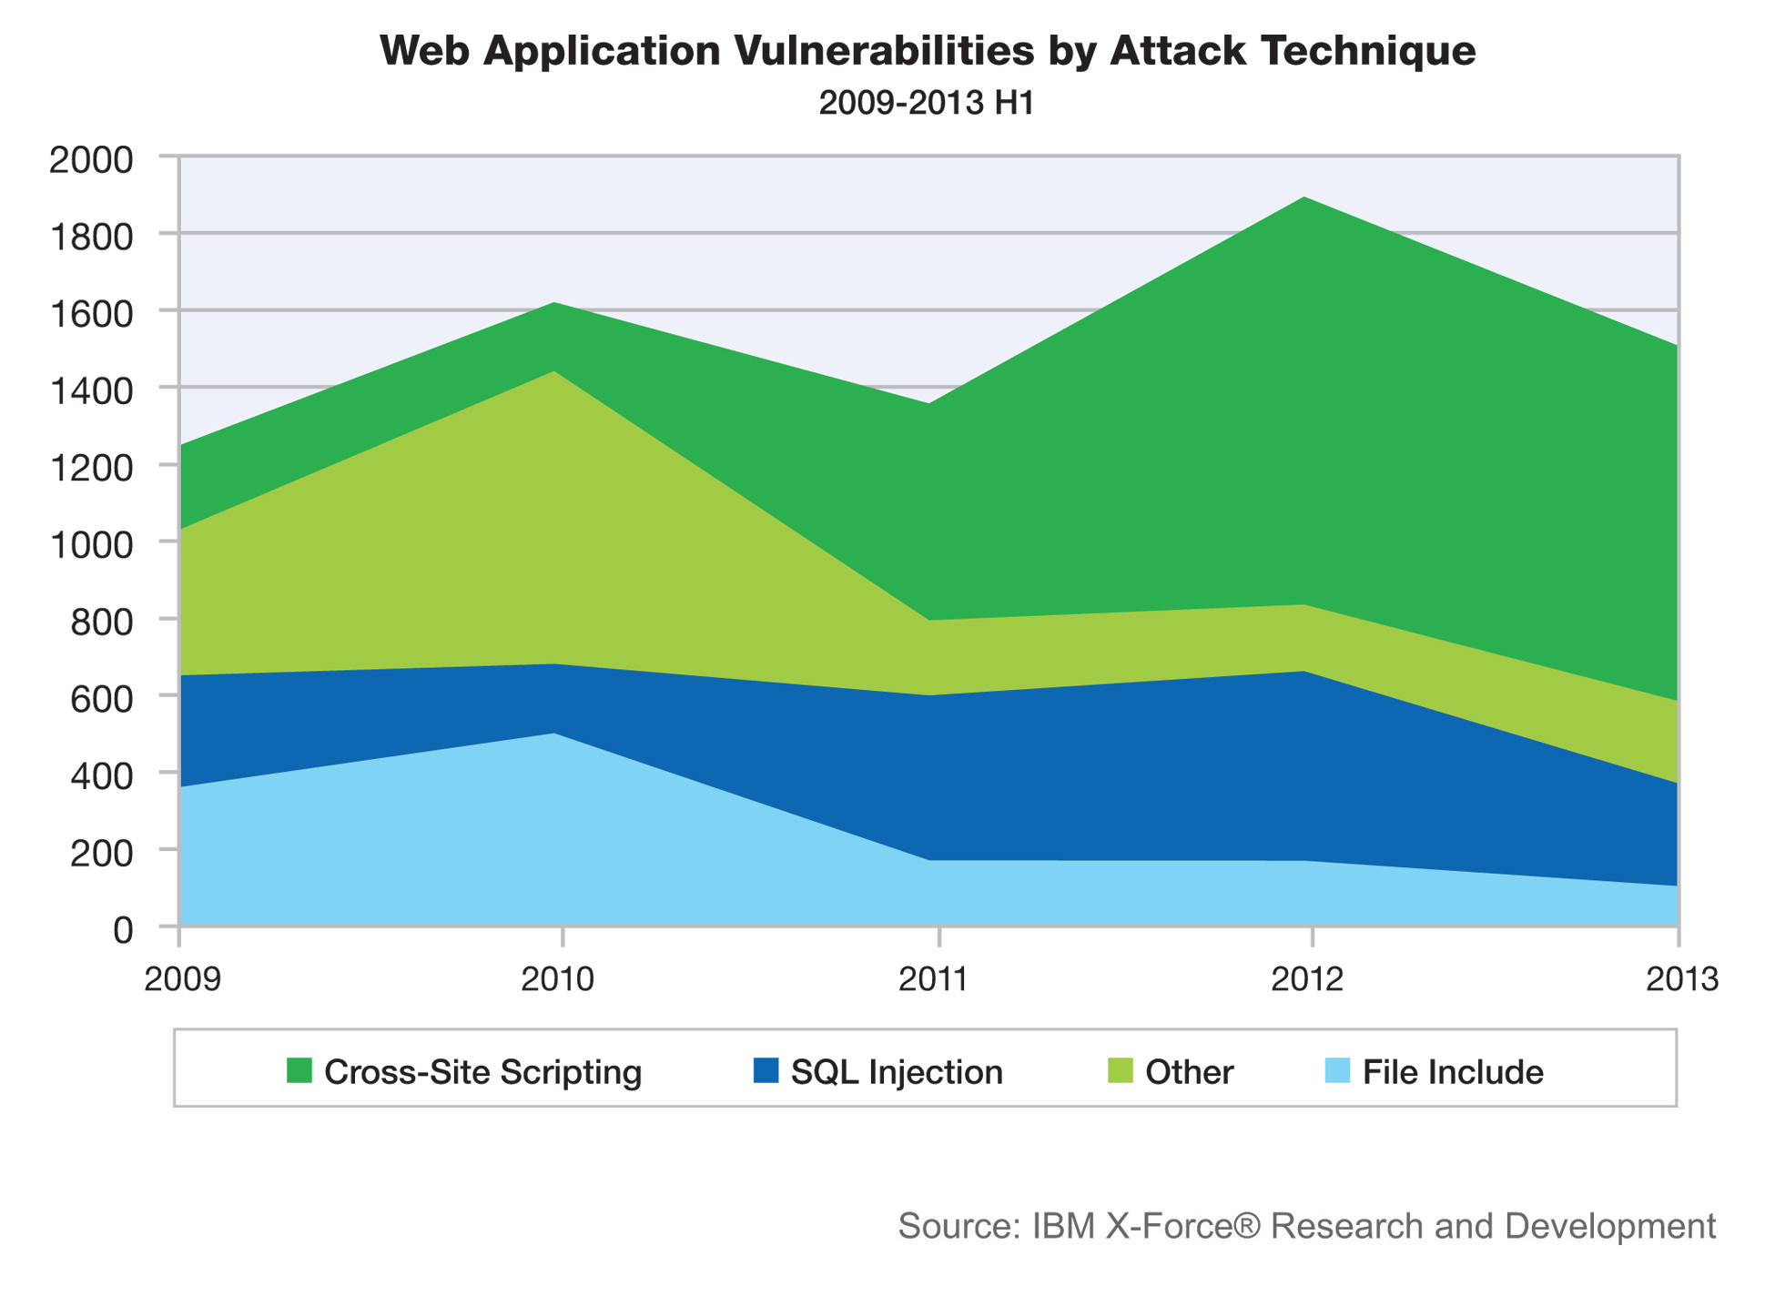
DevOps Security and Continuous Failure: Lessons From Heartbleed, Shellshock, and Countless Other Security Flaws
Notes:
As my sensationalistic title implies, I’d like to draw lessons for us Devops from the stagnant path of web and IT security and the underlying incidents depicted here and perhaps help determine why it contrasts so starkly to the positive trajectories of Moore’s law and application scalability and performance.

Slide 58
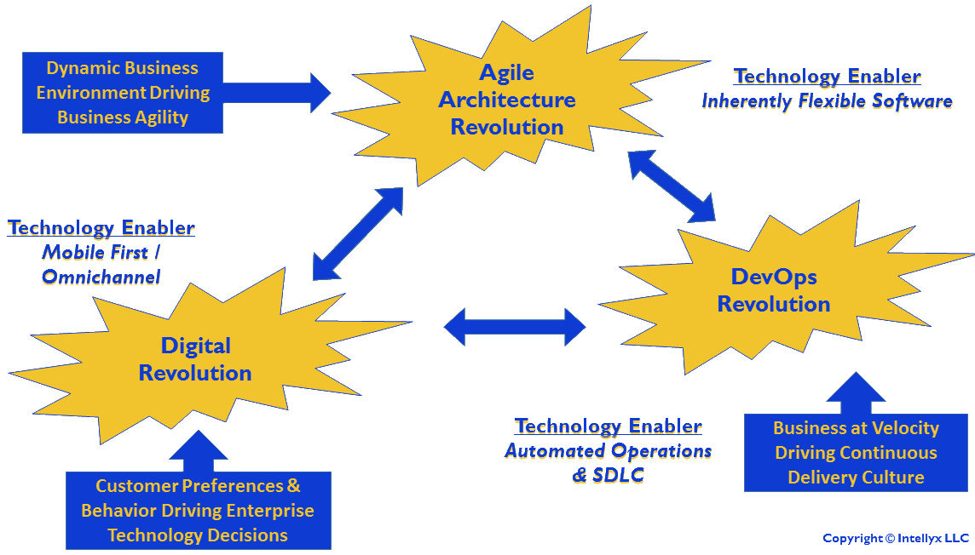
DevOps Security Potential
Software defined sec
Isolation
Collab, control
Situational awareness, rapid response
Notes:
Like many of us, I’m excited by the potential for software defined security, containers and microsservices isolation, and collaboration among dev, ops, and sec people to provide us better control of and insight into application security, broader situational awareness, and the ability to respond more nimbly too security incidents.

Slide 59
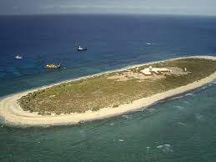
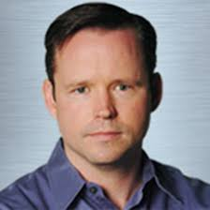
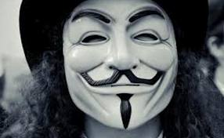


Security Island
Security community
Fear and liability
Unique goals
Black box, reactive tools
Notes:
Another concern is that while dev and ops have historically had friction and conflicting goals and perspectives, the security community is even more of a breed apart, with a focus on fear, narrow interests, and opaque processes and tools that often don’t integrate well with devops.

Slide 60

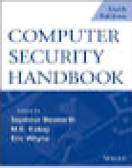
Spiritual Rebirth
Integrate security in devops
Shared mindset
Goals and metrics, tools and tests in pipeline
Notes:
Many say to overcome this division, we need to bring our souls together making security should an integral part of the common devops religion, with a continuous focus on security, security metrics, tools and tests embedded throughout the devops pipeline and better alignment of security and business goals.

Slide 61
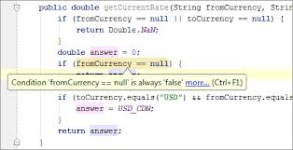
Static Analysis (SAST)
Syntax checking
Structure/complexity
Bugs, duplication
Standards
Security configuration
Notes:
Much work on infusing different security-related methods, practices, and tools into the devops process in underway. Static analysis testing examines the structure and syntax of code, looking for bugs, and adherence to standards. With can also extend include static analysis tools like OpenSCAP discussed at this forum to the current state of app and system configuration compared to secure baselines.
61

Slide 62
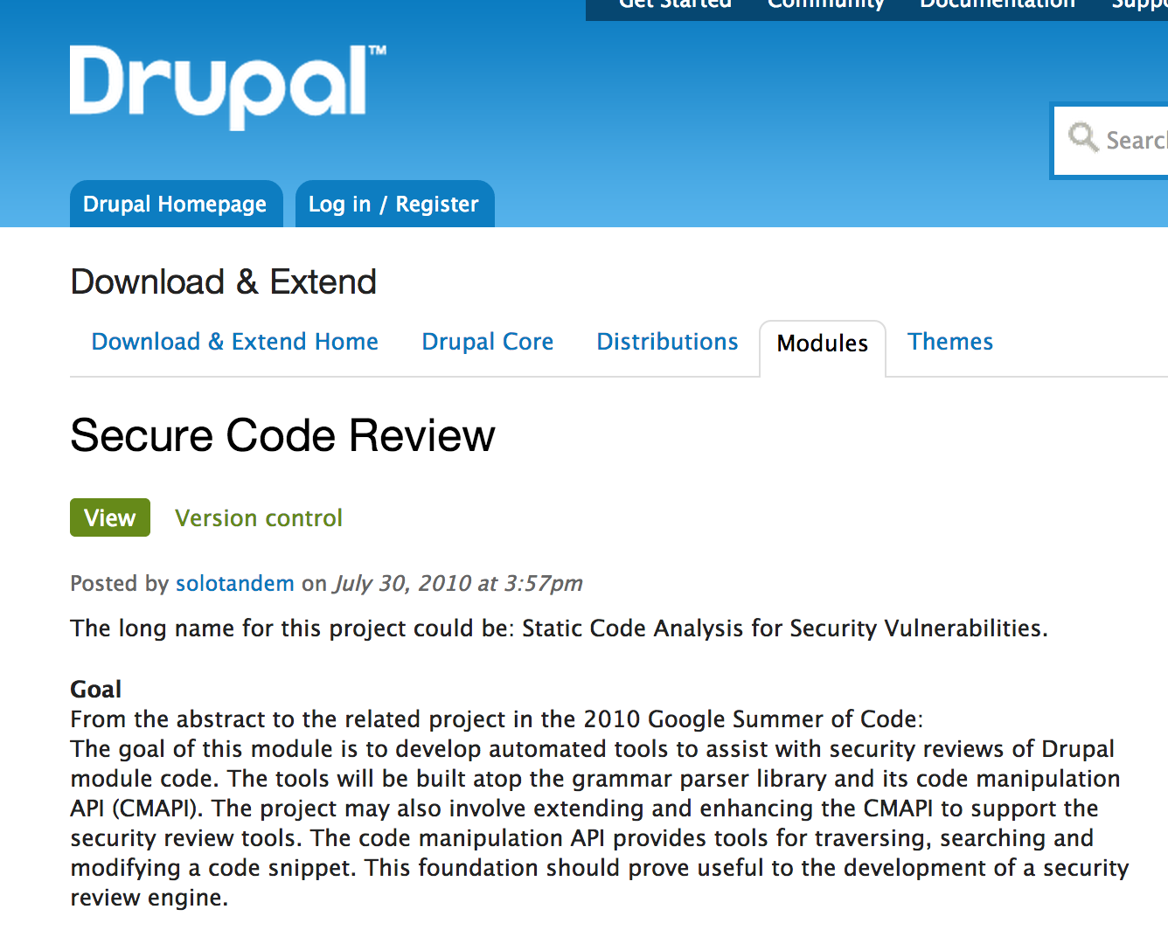
Example: PHP/Drupal
PHP Code sniffer
Coder/Secure Coding Modules
PHPUnit/SimpleTest, Jenkins (STDD/SDD)
Notes:
The quality and availability of static analysis tools vary by programming language and development framework, especially if you want to stick to open source. We do a lot of work in our shop with PHP and Drupal and these are some of the language and application specific static analysis tools we use they can be integrated with testing frameworks and ci systems for security test driven development.

Slide 63
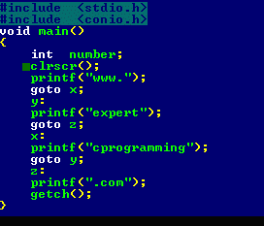
Problems/Limitations
Failed in Heartbleed
Old/complex languages
Bad/complex code
Dynamic languages
Notes:
While some view static analysis tools as a a complete solution for verifying application security, there are substantial problems and limitations. Static analysis has notaby failed in detecting big bugs like Hearbleed, has difficulty with poor or complex code, and also with the dynamic languages increasingly serving the web.

Slide 64

Dynamic App Analysis (DAST)
Pen tests/vuln scans
Web app scanner: ZAP
False positives
Notes:
A natural adjunct to static analysis is dynamic application security analysis including penetration testing and vulnerability scans. On many of our government projects, commercial vulnerability scanners are used as gateways to production. However, many of these tools are not automation and CI friendly, although newer tools like OWSAP ZAP are better. Threre’ also a big problem with false positives and severity ratings aren’t context-senstive.

Slide 65
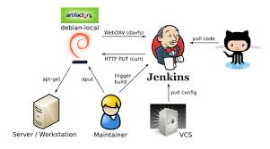
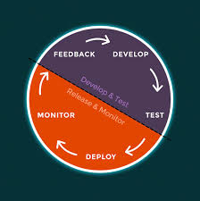
DevOps Pipeline vs. Lifecycle
Continuous feedback
Event aggregation, normalization, correlation
Trickle testing, deployment
Notes:
Rather than concentrating solely on improving static and dynamic security testing on the way release, it’s just important to take advantage of the recent substantial advances in open source application-centric monitoring, event aggretaion, and anomlay detection tin production to deploy more intelligently andn and create continous adaptive security feedback cycle.

Slide 66

Code Review/Collaboration
Code review app
Review board
CI: Jenkins
Paired programming
Notes:
We also need on work on improving key fundamental good practices that are too often neglected in the spirit of the checklist manifesto, triggering a code review tool such Gerrit or Gitlab to ensure a peer looks at all commits. Or benefiting from hands-on paired programming to improve quality and secuiryt, share knowledge and transfer skiils.

Slide 67
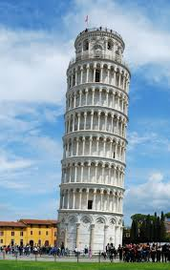
Architectural Risk Analysis
Design flaws vs. bugs
Scope of impact, risk potential
Safeguards
Notes:
Similar to having to get beyond fighting fires in operations, we also need to move beyond bashing bugs in dev to make real progress in security, grappling with the more systematic flaws in our systems design and application achitecture, and strategic perspective to pinpoint and provide safeguards.

Slide 68

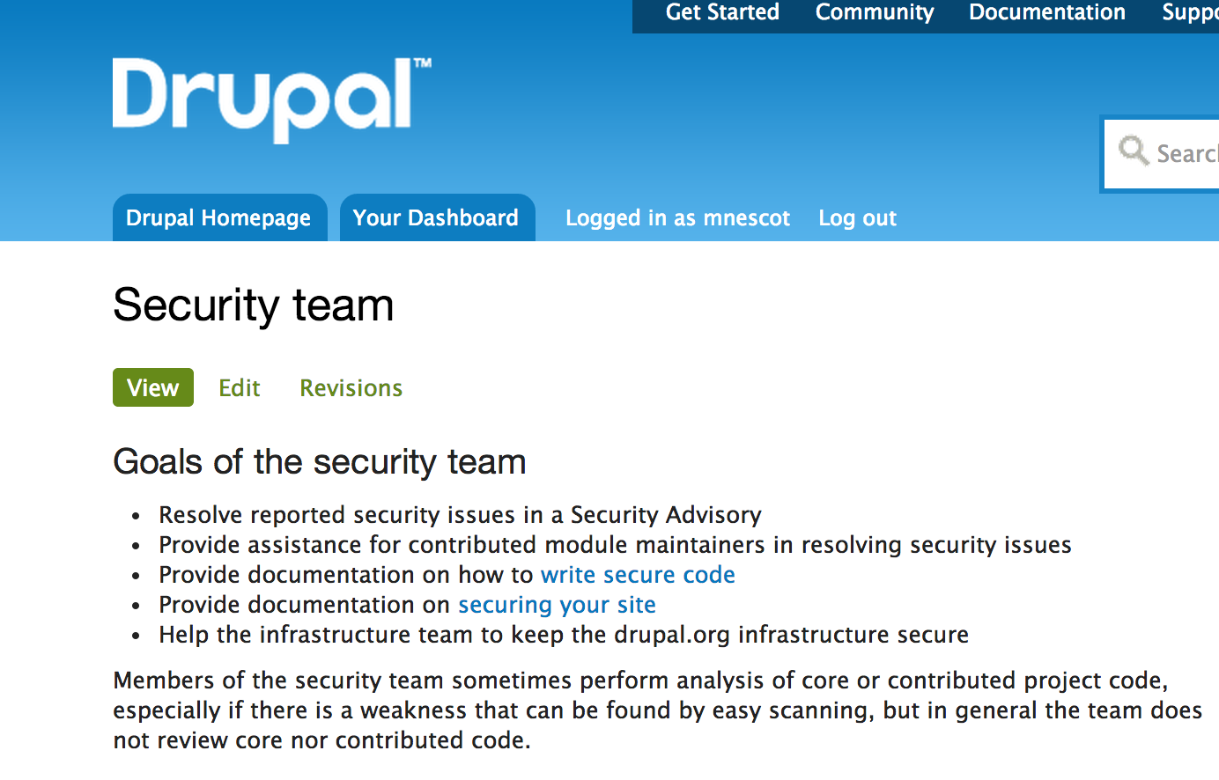
Code Security: Human Factors
Technology, programmer, community
Secure coding guidelines
Dedicated security team
Gateways
Notes:
We should also appreciate how much the security of our stack depends on the security culture of the broader development communities we are involved with. For example, we know there’s a vast difference in the degree to which different open source CMS communites take responsibility through mechanisms such a dedicated security teams for ensuring the security of their platforms and fostering a sense of responsibility.

Slide 69
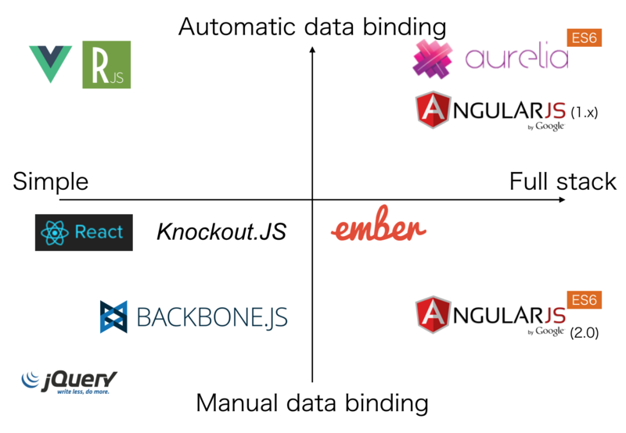
Vendor Management
Check third-party code
Creds, dependencies
Limitations/unknowns
Notes:
Carefully evaluating the security standards and practices of our third-party open source and commercial software vendors is also importnatn in making devops secure, assessing the short and long term security impact of our dependencies on certain javascript frameworks as we evaluate the other qualities and capabilites of these platforms.

Slide 70
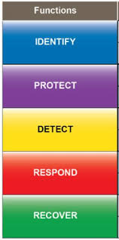
Security Frameworks/Process
CMMI: Security Extension
OWASP ESAPI
FISMA
NIST Cybersecurity
ITIL
ISO 2700
COBIT
Notes:
Although highly elaborate and detailed and somewhat rigid standards like ITI may seem, antithetical to devops and agile, we may have to confirm to them any way and so it can be extremely beneficial to appreciate the shared contenttarion on devops and frameworks like CMMI on statistica, process repeatability,and procssing control and imporiment, using them as guideposts and validation tools.

Slide 71

Risk Management
Leanest stack, minimal privileges
Simplicity: Occam
Open standards
API Security
Notes:
Many security and IT management frameworks emphasize the importance of risk management. In devops, there are major benefits in security, as well as performance and manageablity by ensuring our infrastructure and processes are as lean, simple, and open as possible. If we deliver and communicate everything through APIs, we can focus on optimzing API consumption while minimizing exposure.

Slide 72
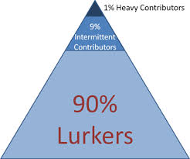
Community Support
Developers and ops in security
Contribute time and $ Show value and cost
Notes:
Besides keeping our stack lea, the the devops and open source community can collectively limit by being more generaous with code, time and money, investing more in the benefits to acknowldete of negelcted projects, acknowlindg the value and costs and potentail risks of lurking and freeloading..

Slide 73

Technology to the Rescue: People are People
Developers are developers
Better languages: Go and Elixir
Safeguards (e.g., MFA)
Notes:
Many hope we will be rescued from much security risk eventually through improved technology, modern languates such as Go, Elixr, and scala that do better jobs of managing and systematically abstracting away potential vulnerabilites and mitigating safeguards like multifactor auth, so that developers can be freed from needing as much security expertise.

Slide 74

Security Metrics & Marketing
App security
Config management
Financial
Incident management
Patch management
Vulnerability management
Balanced Sec Scorecard
Notes:
Finally, regardless of how we are able to improve security, we need much better ways of measuring where we’re and how much we’re improving. Meaninful security metrics and a balanced security scorecard tailored to our specific risk and requirements.

Slide 75
DevOps Revolution
#
-*C*ulture – Own the change to drive collaboration and communication
-*A*utomation – Take manual steps out of your value chain
-*L*ean – Use lean principles to enable higher cycle frequency
-*M*etrics – Measure everything and use data to refine cycles
-*S*haring – Share experiences, successful or not, to enable others to learn

Slide 76
DevOps Agile Continuum
-Continuous Integration
-Continuous Delivery
-Continuous Release
-Continuous Improvement
-Continuous Monitoring

Slide 77
DevOps Potential
-Software Defined Security
-Isolation
-Precise control
-Situational awareness
-Rapid response
-Collaboration
-Immutability

Slide 78
DevOps Tools
Version Control and Code Review (Git, GitHub, Gerrit)
Configuration Management (Puppet)
Virtualization (Vagrant, Docker)
Microservices
Cloud Computing (AWS, Azure)

Slide 79
Open Source

Slide 80
Open Source
Collaboration
Governance/Review
Extendable
Modular
Security Infrastructure As Code
COTS

Slide 81
“Honorary” Open Source/DevOps Community Members
- Apple
- Google
- Amazon
- GitHub

Slide 82
DevOps Open Source
Google (Kubernetes, Go)
Netflix (Security Monkey)
Docker (Docker)
HashiCorp (Vagrant, Packer)
Cloud Bees (Jenkins)
Sound Cloud

Slide 83
Open Source Adoption
Microsoft
IBM
Oracle
HP

Slide 84
Government Open Source
NSA SELinux
Open Source Software
White House

Slide 85
Federal Government
OSS should be leveraged by the U.S. federal government to realize open government and save tax payers money, especially at a time when controlling wasteful spending could not be more important. In this regard, there are six reasons for the government to move to OSS:
1. Improved Security and Privacy over proprietary software;
2. Increased procurement speed so agency's can get their programs deployed faster, particularly for rapid prototyping, experimentation, and where the ability to “test drive” the software is important;
3. No lock into one vendor, support can be provided by anyone since the code is in the public domain;
4. Reduced cost of license and support, on average, open source products provide same functionality at a 80-90% lower cost to the taxpayers;
5. Improved quality, normally, supported open source products go through three times more quality reviews than proprietary software as part of community review, indemnification review, and then productizing; and,
6. The Government can become part of the open source community and directly inject their specific requirements into the product.

Slide 86
Open Source
Linux
Package Management
Modular

Slide 87
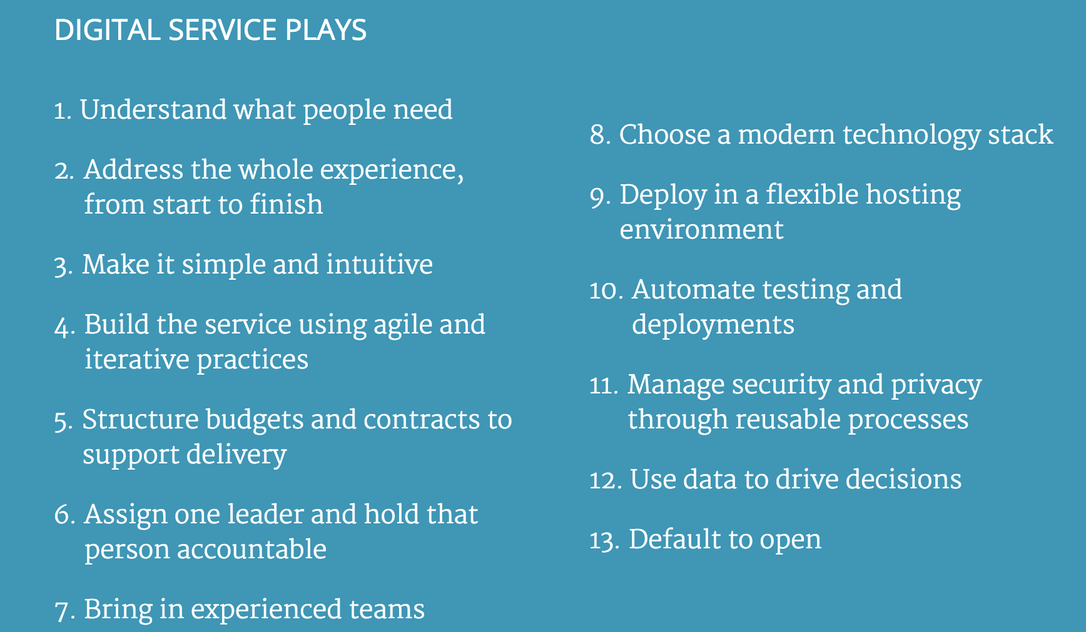

Slide 88
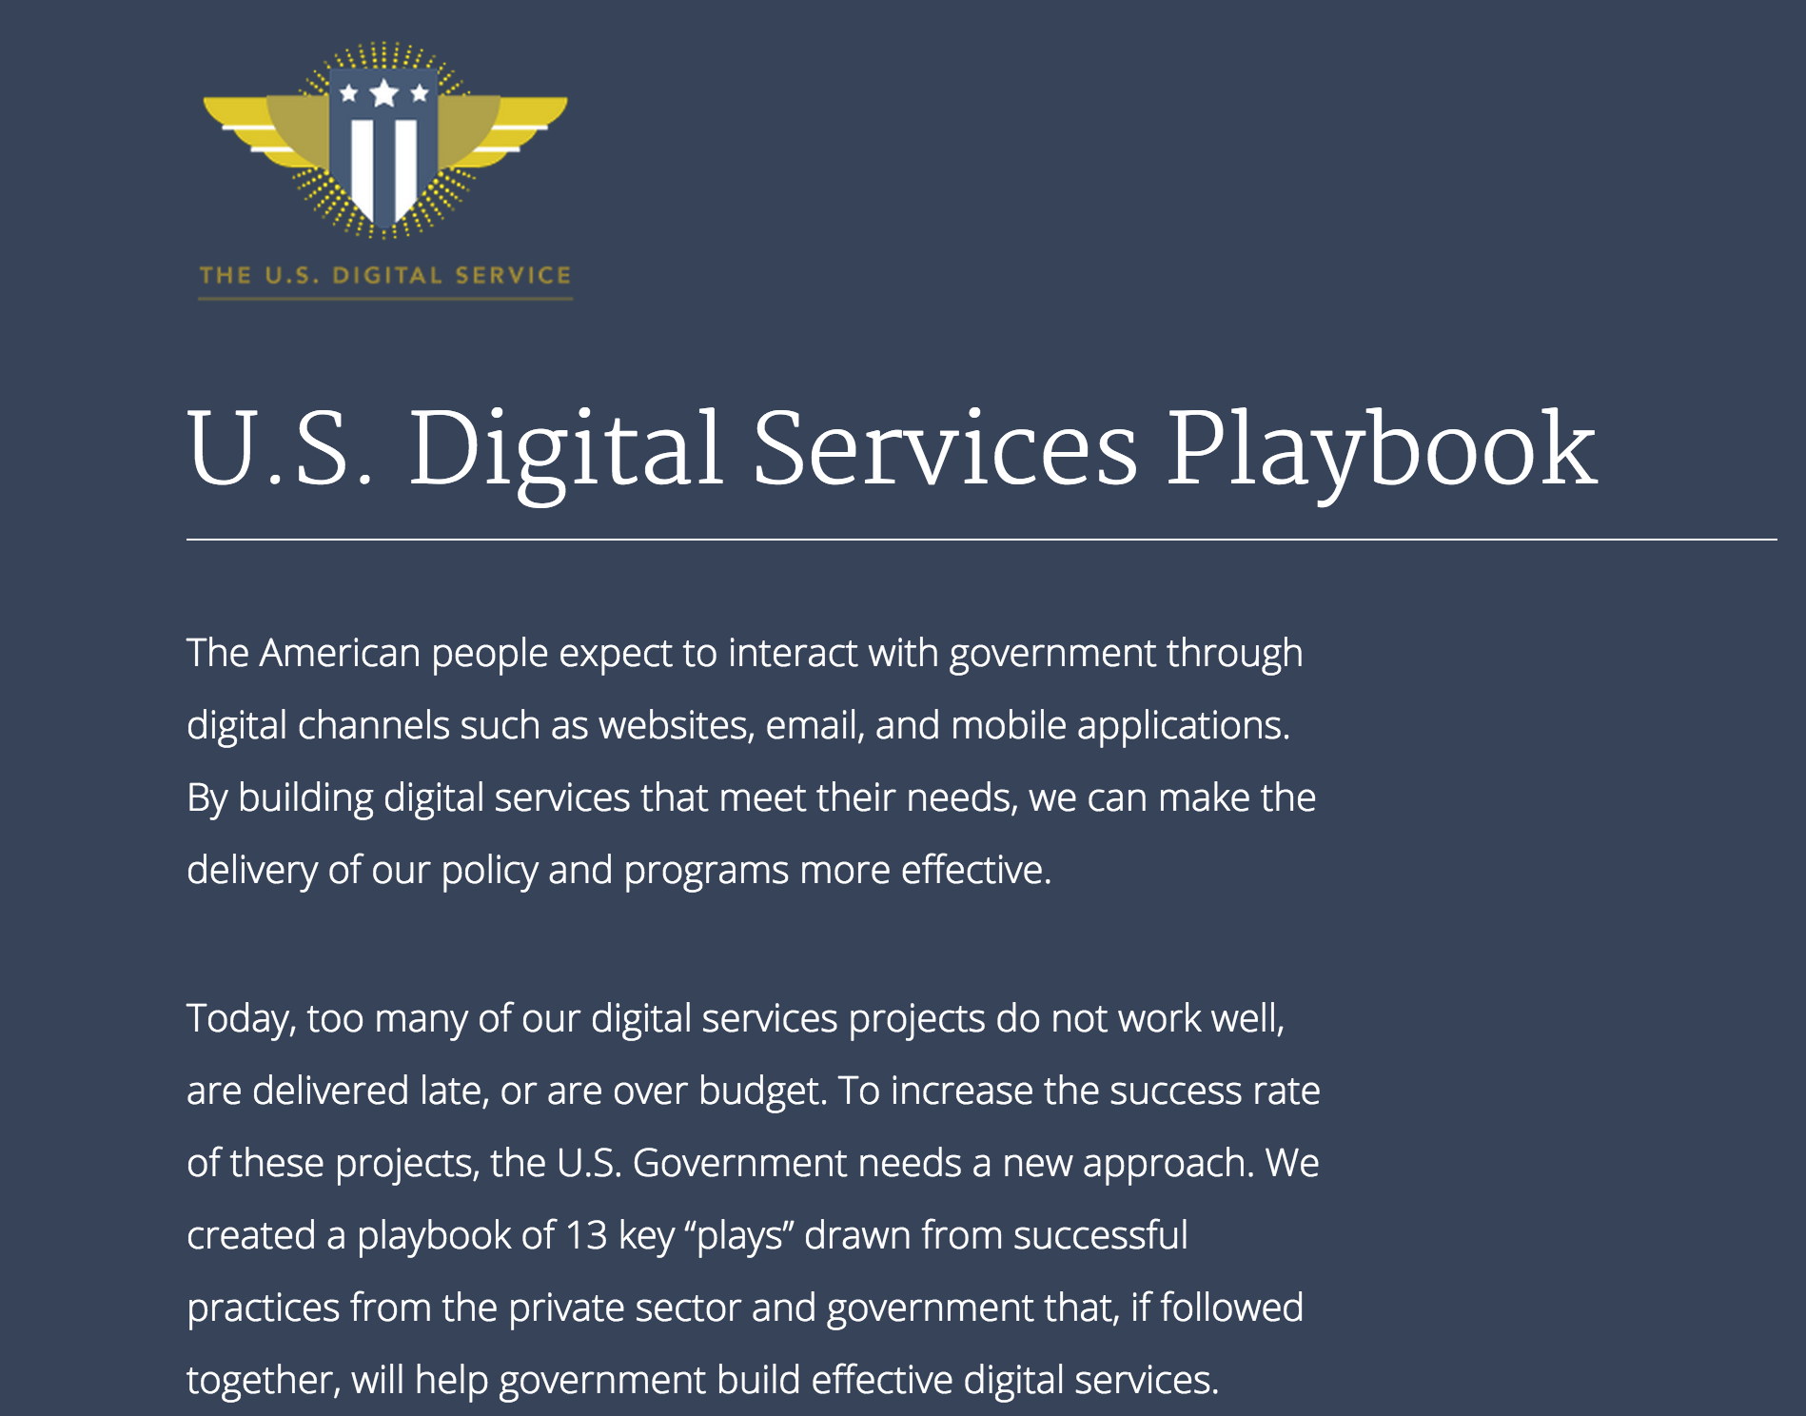

Slide 89
Open Source
---
#Configuration as Code
-Docker, Vagrant
-Git
-Linux
-Light-weight IDE (Vim, Sublime, Atom)

Slide 90
Version Control

Slide 91
Centralized vs. Distributed Version Control Systems
Centralized:
CVS, Subversion, TFS,
Distributed:
Git, Mercurial, Bazaar

Slide 92
Centralized vs. Distributed Version Control Systems
Centralized:
CVS, Subversion, TFS,

Slide 93
FreeBSD Compromise vs. Linux Kernel.org Compromise

Slide 94
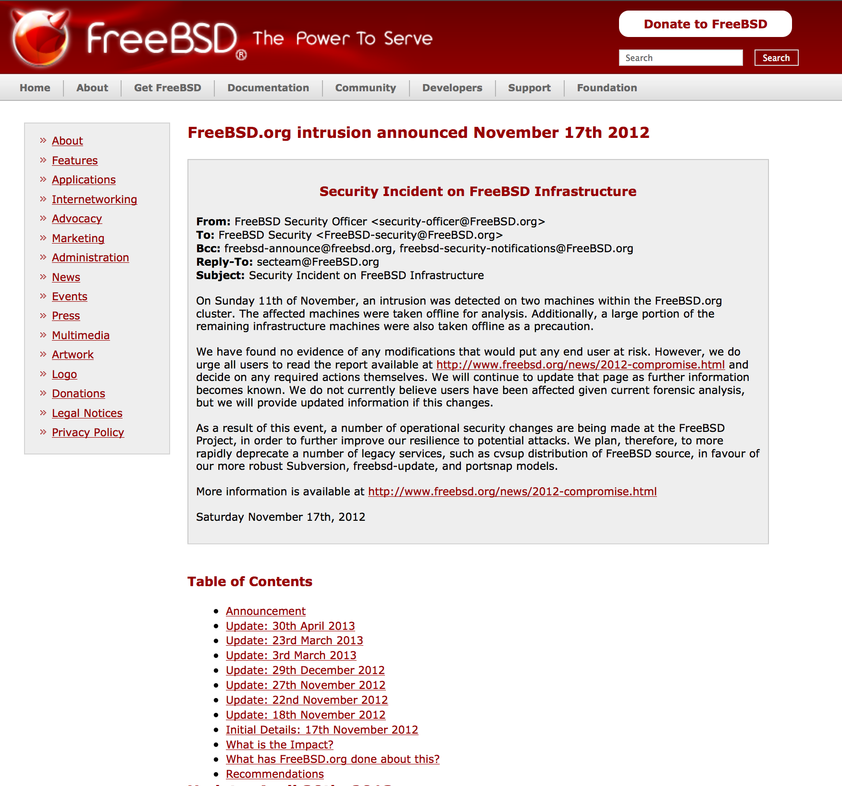

Slide 95
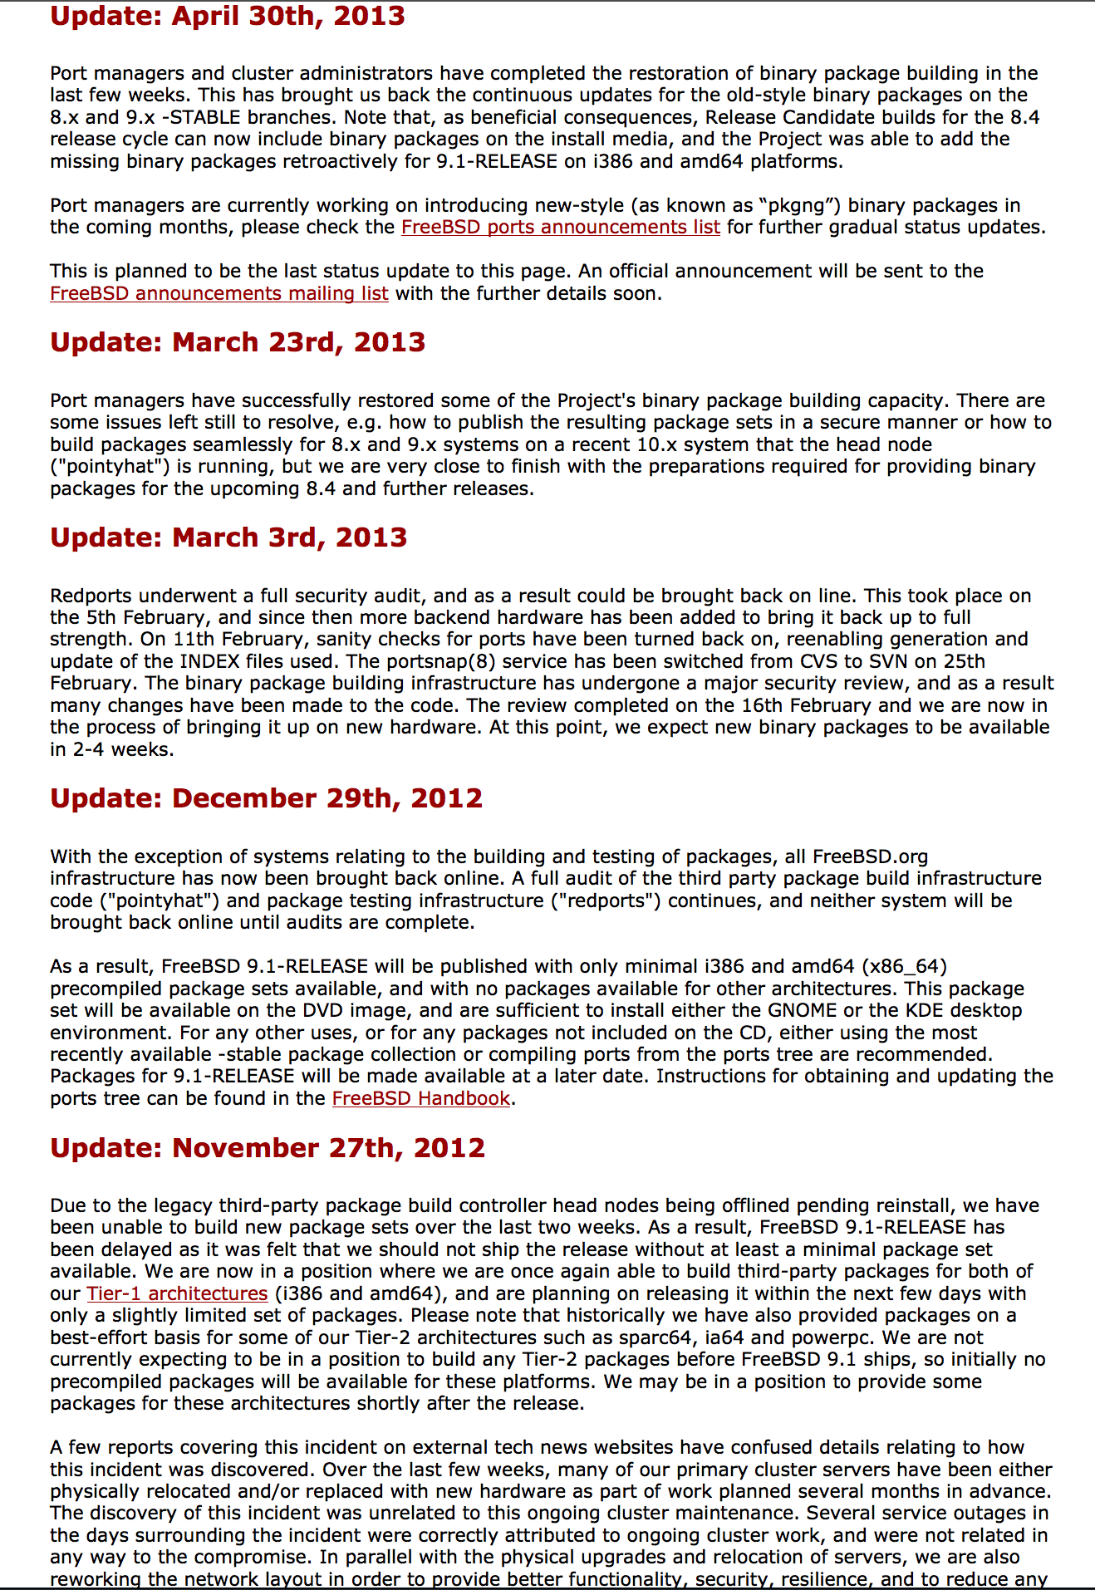

Slide 96
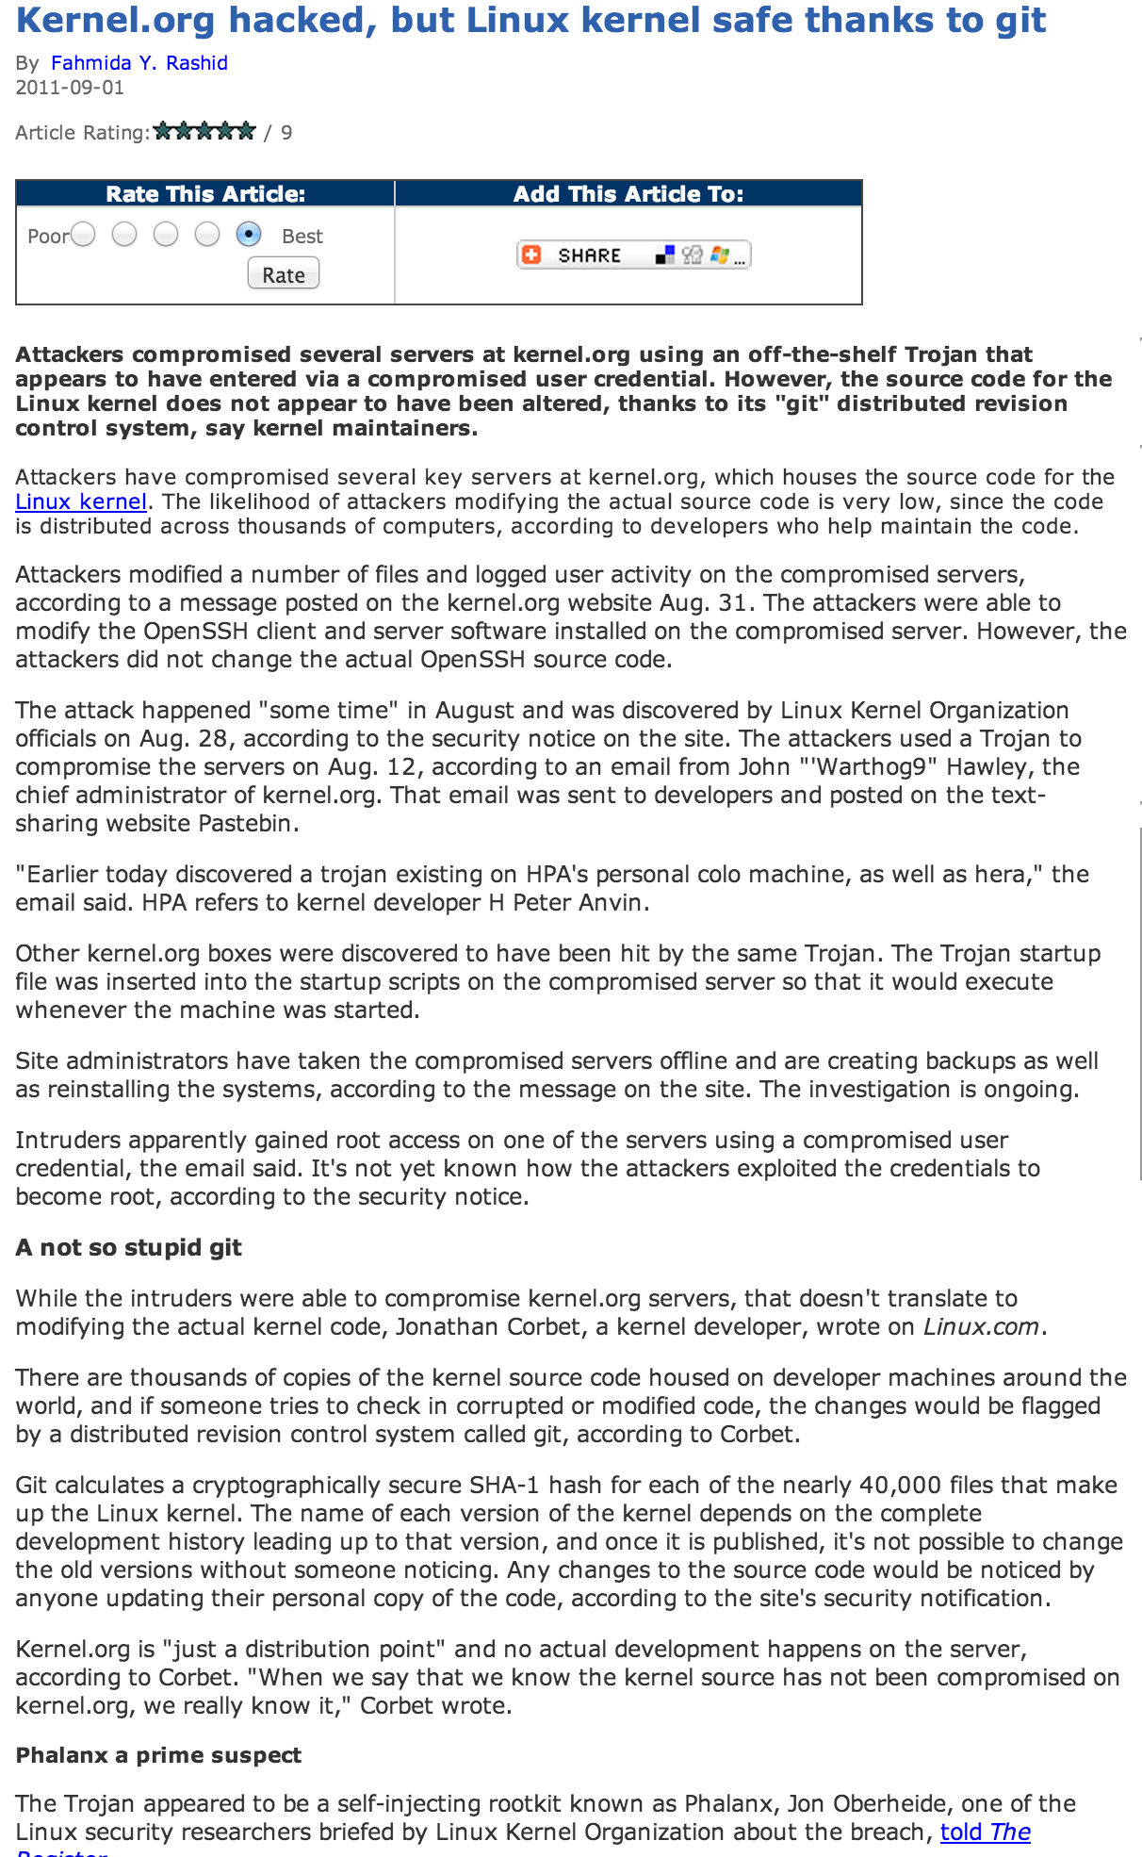

Slide 97
Git vs. GitHub
https://training.github.com/kit/downloads/github-git-cheat-sheet.pdf
https://github.com/WhiteHouse
Government GitHub: https://government.github.com/
Non-code uses

Slide 98
Git Conventions and Jargon
-“Pull Request”
“Fork”,”Clone”
“Commit”
“Push”
“Repo”

Slide 99
Code review
-Trigger code review on checkin
-Many eyes
-Know what's out there
Dev on duty

Slide 100
Configuration Management

Slide 101
Configuration Management
Major Control Family in FISMA
Standardize Secure Platforms
Prevent Configuration Drift
Monitor, Auto Correct configuration
Create users, manage permissions andfiles

Slide 102
Configuration Management
Planning
Identification and Control
Accounting
Verification and Audit
Change Management

Slide 103
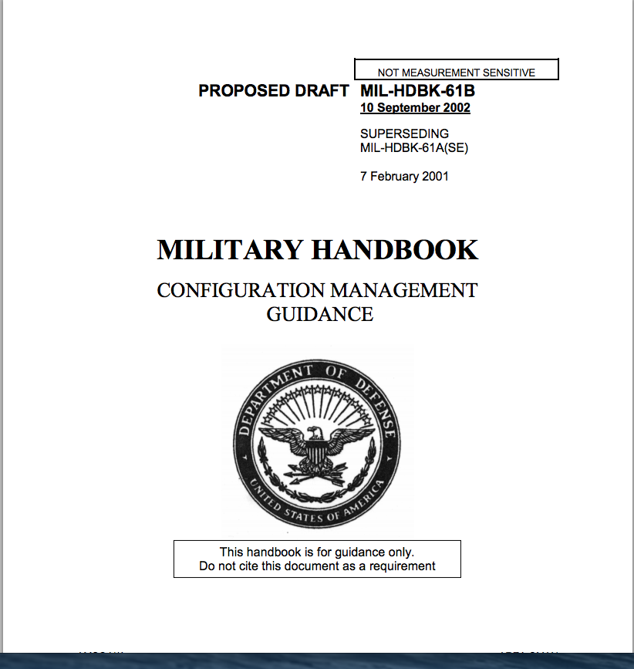
Configuration Management Roots

Slide 104
Configuration Management
CFEngine
Puppet
Chef
Ansible
Salt
SCCM
DCS

Slide 105
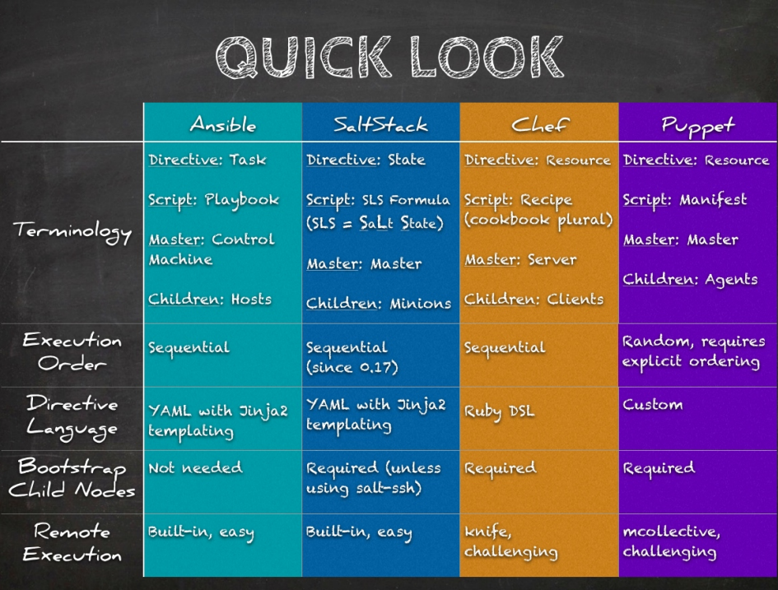

Slide 106
Puppet
Install software
Manage files and folders within the filesystem
Manage cron jobs
Run commands
Manage users and groups
Creating configurable classes
How to use third-party Puppet modules and Puppet Forge
How to manually run Puppet to provision a machine

Slide 107
Puppet
Manifests
Modules
Provision Many Things (VM’s containers)

Slide 108
Ansible
SSH vs.
YAML

Slide 109
Virtualization

Slide 110
Virtualization
- Bare metal
- Virtual machines
- VirtualBox
- VMWare
- HyperV
- Xen
- KVM

Slide 111
Virtualization- Kernel-level
- BSD Jails
- Linux Containers
- Solaris Zones
- Windows Containers

Slide 112
DevOps-Friendly Virtualization
-Vagrant (Vagrant Box)
-Docker (Docker Container)
-Git

Slide 113
docker:
process isolation
logical segregation of duties
lower attack surface
control groups and namespaces: stronger isolation
immutability
different update and patching model
precise control
enhanced insight
By using cgroups, system administrators gain fine-grained control over allocating, prioritizing, denying, managing, and monitoring system resources. Hardware resources can be appropriately divided up among tasks and users, increasing overall efficiency.
Multiple separate hierarchies of cgroups are necessary because each hierarchy is attached to one or more subsystems. A subsystem ⁠[2] represents a single resource, such as CPU time or memory. Red Hat Enterprise Linux 6 provides ten cgroup subsystems, listed below by name and function.

Slide 114
vailable Subsystems in Red Hat Enterprise Linux
blkio — this subsystem sets limits on input/output access to and from block devices such as physical drives (disk, solid state, USB, etc.).
cpu — this subsystem uses the scheduler to provide cgroup tasks access to the CPU.
cpuacct — this subsystem generates automatic reports on CPU resources used by tasks in a cgroup.
cpuset — this subsystem assigns individual CPUs (on a multicore system) and memory nodes to tasks in a cgroup.
devices — this subsystem allows or denies access to devices by tasks in a cgroup.
freezer — this subsystem suspends or resumes tasks in a cgroup.
memory — this subsystem sets limits on memory use by tasks in a cgroup, and generates automatic reports on memory resources used by those tasks.
net_cls — this subsystem tags network packets with a class identifier (classid) that allows the Linux traffic controller (tc) to identify packets originating from a particular cgroup task.
net_prio — this subsystem provides a way to dynamically set the priority of network traffic per network interface.
ns — the namespace subsystem

Slide 115
Infrastructure as Code
Precisely Defined
Auditable
Controllable
Reproducible
Predictable
Executable Documentation (!!!!!!)

Slide 116
Software Defined Defined Infrastructure
SDIM: Machine Configuration (Virtualization, Chef & Puppet), AWS, VMWare & OpenStack
SDN: Software Defined Networking
SDS: Software Defined Storage
Software Defined Application Security?

Slide 117
Vagrant
Development Environments
Up to Production
Customize Virtual Machines
Providers and Provisioners
Packer and Atlas
Infrastructure as Code

Slide 118
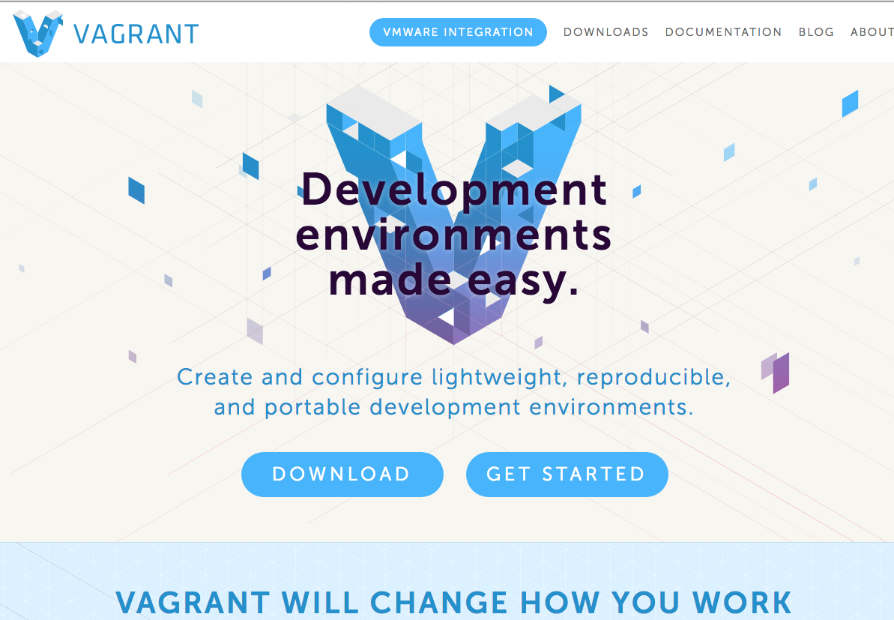

Slide 119
Docker Fundamentials: Dockerfile
FROM: Base image
MAINTAINER: Author name
RUN: Execute a shell or exec command on top of existing image
ADD/COPY: Copy files from a URL or local area to container path
EXPOSE: Open ports for listening
CMD/ENTRYPOINT: What the container runs
VOLUME: Storage area, files or folders created, mutable
USER: Run as non-root user
WORKDIR: Path for commands

Slide 120
Docker Fundamentials: DockerHub
Repositories and images
Operating systems and applications
Instructions on Use
Link to image manifest, history, and development repository (GitHub)

Slide 121
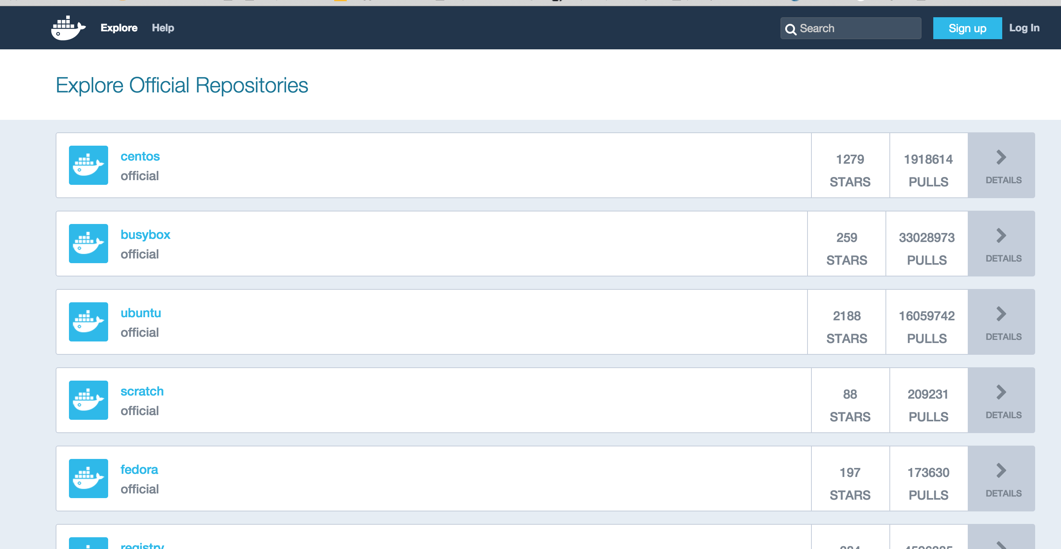

Slide 122
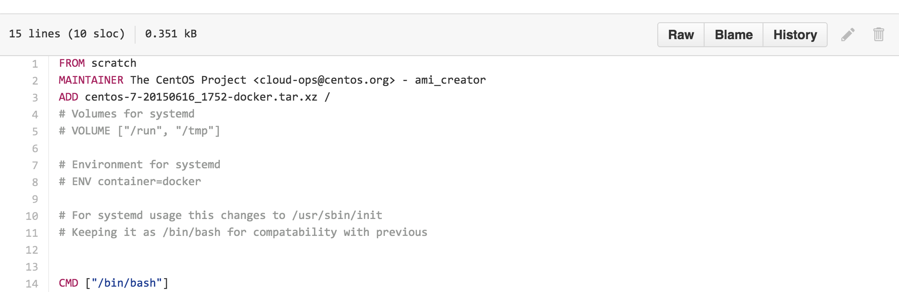

Slide 123


Slide 124
Container Security
Microservies
Security Architecture vs. Networkgin
Application and service based

Slide 125
#Microservices
-Loosely coupled
-Limited footprint
Docker security model
Application level security

Slide 126
ere possible.
By contrast, our Identidock application has a Python web application talking to a JavaScript service and a C key-value store across 3 containers. Later on in the book, we will see how to plug-in more microservices to Identidock with very little work, including a reverse-proxy in Chapter 9 and a monitoring and logging solution in Chapter 10.

Slide 127
Minimal Stack
Remove dependencies
Minimal OS: CoreOS, Atomic, Rancher (5 bm)
Minimal container: Alpine (alternative C library)
Performance, security, and usability

Slide 128
Disposable Infrastructure
Immutability
-Rebuild rather than fix
-Cows vs. pets
-Scalability
-Resilience
-"Golden image”
Configuration drift

Slide 129
Orchestration
Kubernetes
Heat
Fleet
TOSCA
MaestroNG
Fig/Docker Compose

Slide 130
Orchestration
Docker Compose
Vagrant

Slide 131
Continuous Integration

Slide 132

Pipeline

Slide 133
Continuous Integration
Jenkins
-Compose Pipeline
-Automation
-Plugins
-Communication
-Auditing

Slide 134
Pipleline
Gerrit Trigger
Phing (Static code analysis)
SSH scripts, Platform tools:Drush
Docker image build
Zed Proxy (vuln, pen tesint)

Slide 135
Monitoring

Slide 136
Open Source Monitoring/Metrics
-Monitorama
-Notifications, metrics, awareness
-Security
-ELK (Elasticsearch, Logstash, Kibana)

Slide 137
Monitoring
Nagios
Sensu
CAdvisor
Promethus

Slide 138
Prometheus
Time series database
Extensions
Visualization and alerts

Slide 139
Monitoring
Traditional: Computer systems and services, monolithic, static
Next generation: Application systems and services, customized, adaptable,

Slide 140
Communication

Slide 141
Communications
-Slack
-HipChat
-People and Bots
-Integrations: Jenkins, JIRA, Redmine
-Insight
-Audit

Slide 142
GitHub
Threat Exchanges

Slide 143
Cloud

Slide 144
Amazon Web Services (AWS): market leader, FedRAMP, GovCloud (ITAR)
Microsoft Azure, Google, IBM, VMWare
Infrastructure as a service (IAAS)
Platform as a service (PAAS)
^{Software as a service (SAAS)}

Slide 145
Amazon Web Services (AWS): market leader, FedRAMP, GovCloud (ITAR)
Infrastructure as a service (IAAS)
Platform as a service (PAAS)
^{Software as a service (SAAS)}

Slide 146
(FedRAMP),3 was designed to focus on three main areas: authorization, continuous monitoring, and federal security requirements. The initial goal of FedRAMP was to establish a unified risk management process that:
• Increased security of cloud solutions through a common assessment approach.
• Eliminated duplication of effort and achieved cost-savings through efficiency.
• Enabled rapid acquisition through leveraged authorizations.
• Improved reuse of authorization packages based on a common set of security requirements.
• Facilitated use of shared services across multiple federal agencies.
• Integrated a government-wide security approach.

Slide 147
Cloud
AWS CLI and SDK
S3
RDS
EC2
DynamoDB
ECS

Slide 148
Summary & Future

Slide 149
SANS Top 20: DevOps
Inventory of Authorized and Unauthorized Devices: Cloud manages hardware
Inventory of Authorized and Unauthorized Software: Virtualization and containerization constrict and define software
Secure Configurations for Hardware & Software on Laptops, Workstations, & Servers: Infrastructure as code and configuration management define and enforce security
Continuous Vulnerability Assessment and Remediation: Microservices enable continuous service-oriented, application-centric monitoring and assessment
Malware Defense: Immutable infrastructure prevents malware installation

Slide 150
SANS Top 20: DevOps (cont).
Application Software Security: Continuous integration includes application security tests and checks
Wireless Device Control: Cloud computing limits wireless access
Data Recovery Capability: Infrastructure as code is readily archived and reproduced
Security Skills Assessment & Training: DevOps communication builds security skills
Secure Configurations for Firewalls, Routers, & Switches: Network infrastructure as code defines and enforces security

Slide 151
SANS Top 20 (cont)
Limitation & Control of Network Ports, Protocols, & Services: Network infrastructure as code manages and restricts connectivity
Controlled Use of Administrative Privileges: Virtualization and containerization create sandbox environments. Microservices support least privilege
Boundary Defense: Virtualization creates additional, stronger boundaries
Maintenance, Monitoring, & Analysis of Audit Logs: Virtualization manages and integrates logging
Controlled Access Based on Need to Know: Automation manages access

Slide 152
SANS Top 20 (cont)
Account Monitoring & Control: Continuous integration improves account auditability
Data Loss Prevention: Immutable infrastructure and microservices help concentrate and control dynamic and sensitive data
Incident Response & Management: Continuous integration and infrastructure as code allow quicker identification of and more information on incidents
Secure Network Engineering: Composable infrastructure supports secure architectural design
Penetration Testing & Team Exercises: Infrastructure as code and continuous integration support continuous testing and team collaboration

Slide 153


Slide 154


Slide 155


Slide 156


Slide 157
Windows Container Service
Window Server Technical Preview
Azure
Visual Studio
Docker
Powershell

Slide 158


Slide 159


Slide 160


Slide 161


Slide 162


Slide 167


Slide 168


Slide 169


Slide 170


Slide 171


Slide 172


Slide 173


Slide 174


Slide 175


Slide 176


Slide 177


Slide 179


Slide 180


Slide 181


Slide 182


Slide 183


Slide 184


